Slide 1
Using Vespidae – Activity Log
Vinh Nguyen

Slide 2
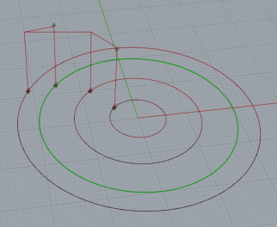
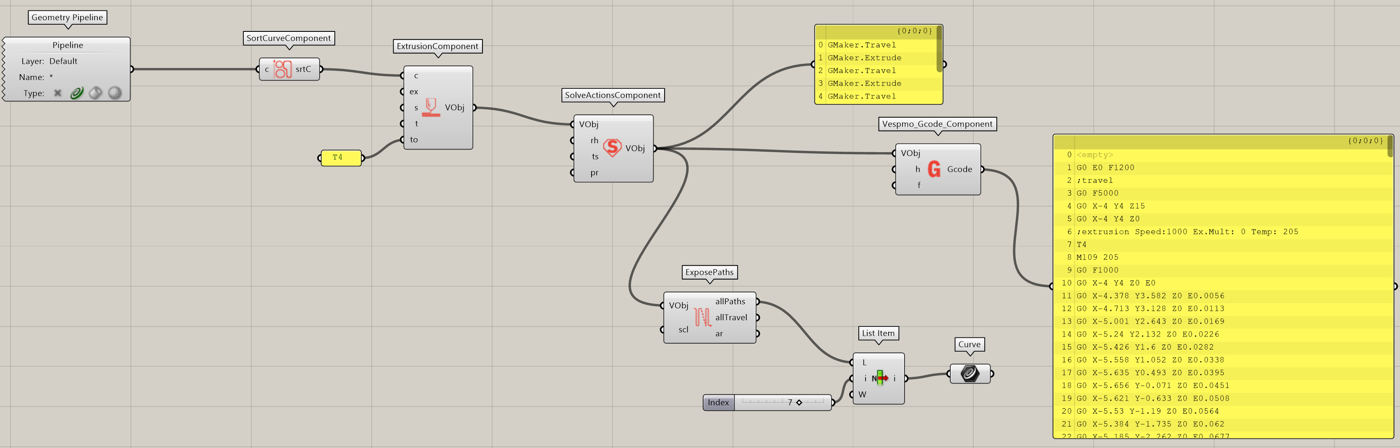
4/4/2022 Quick Tests
How does the sorting work again? Not sure why the highlighted circle ends up being the last circle that gets printed.
Wait just kidding that last one has a slightly higher Y coord because of where I clicked when I made the circle. This might be a mild annoyance/thing I need to remember if I’m building toolpaths in Rhino first instead of in Grasshopper
I realize I have to define my own brim so that my prints start off with filament. Makes sense to me, just hadn’t realized it at first

Slide 3
4/5/2022
Am currently trying to figure out how to connect my computer via ethernet to the Raspberry Pi. I want to make sure this setup isn’t going to wreck anything?
Actually, I can now open the DWC on my laptop, but the config with a Raspberry Pi does not allow network related commands (M552-554) that set an ethernet address. In that case, I’m not sure how the upload G-code process works??
Oh wait just kidding again. I’ve successfully uploaded that code!

Slide 4
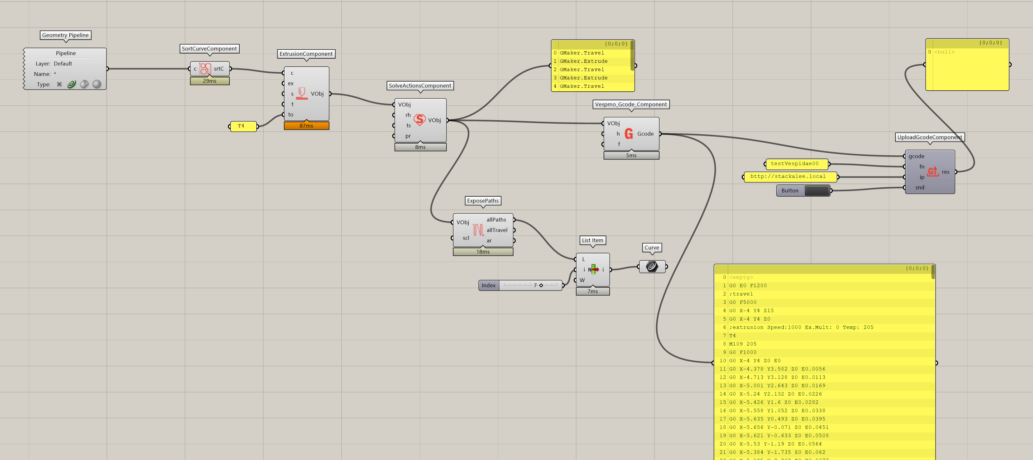
4/5/2022
This is the new grasshopper script. It uploads properly and the simulated movement succeeds. It didn’t like that first command, G0 E0 F1200, but after I commented that out, simulation was successful.

Slide 5
4/6/2022
Added the headers that I typically use for PrusaSlicer
Extrusion was way more than I expected. Realized that’s because slicers I use depend on relative extrusion values, while Vespidae uses absolute extrusion coordinates, which results in major overextrusion.
Changing the extrusion to absolute stopped the overextrusion, but the default multiplier is not enough, there’s almost no extrusion coming out in that case.
Extrusion multiplier 5 gets closest to an expected print, but ends of circles become little blobs

Slide 6
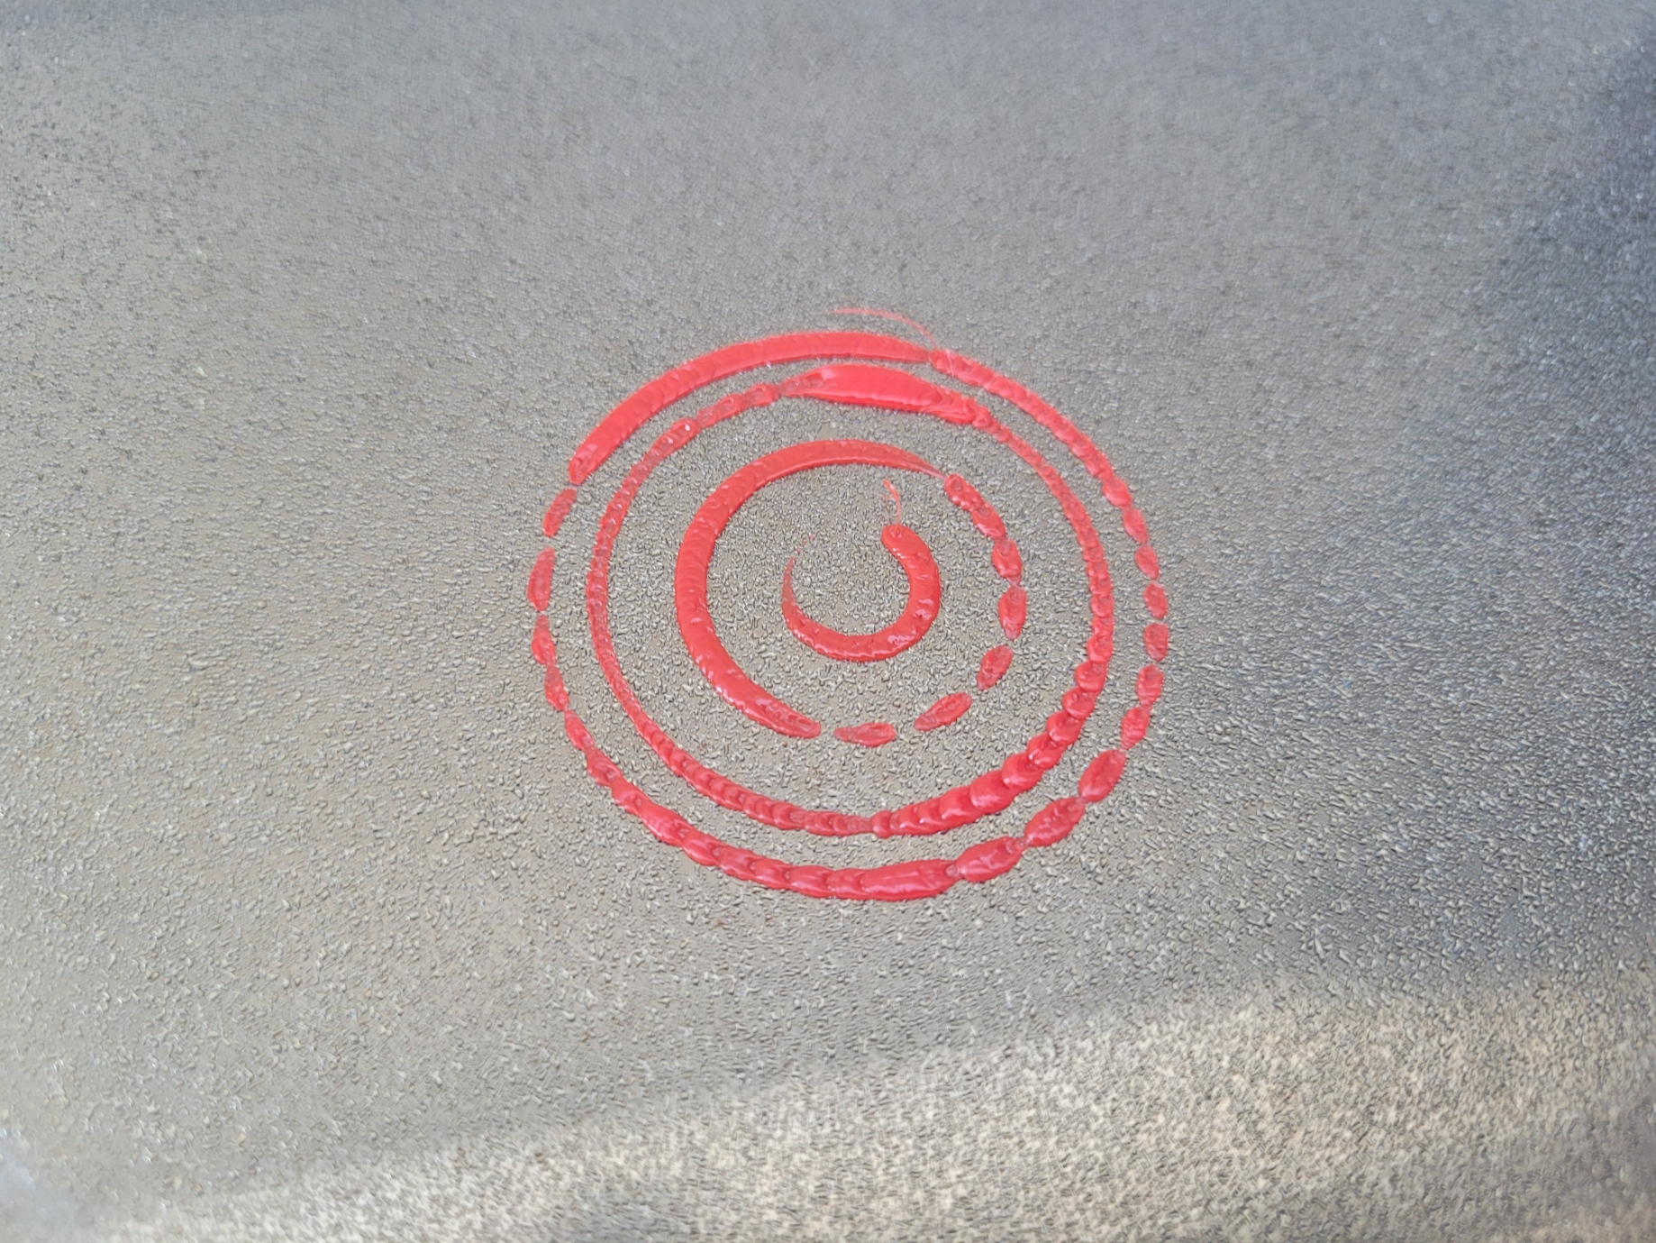
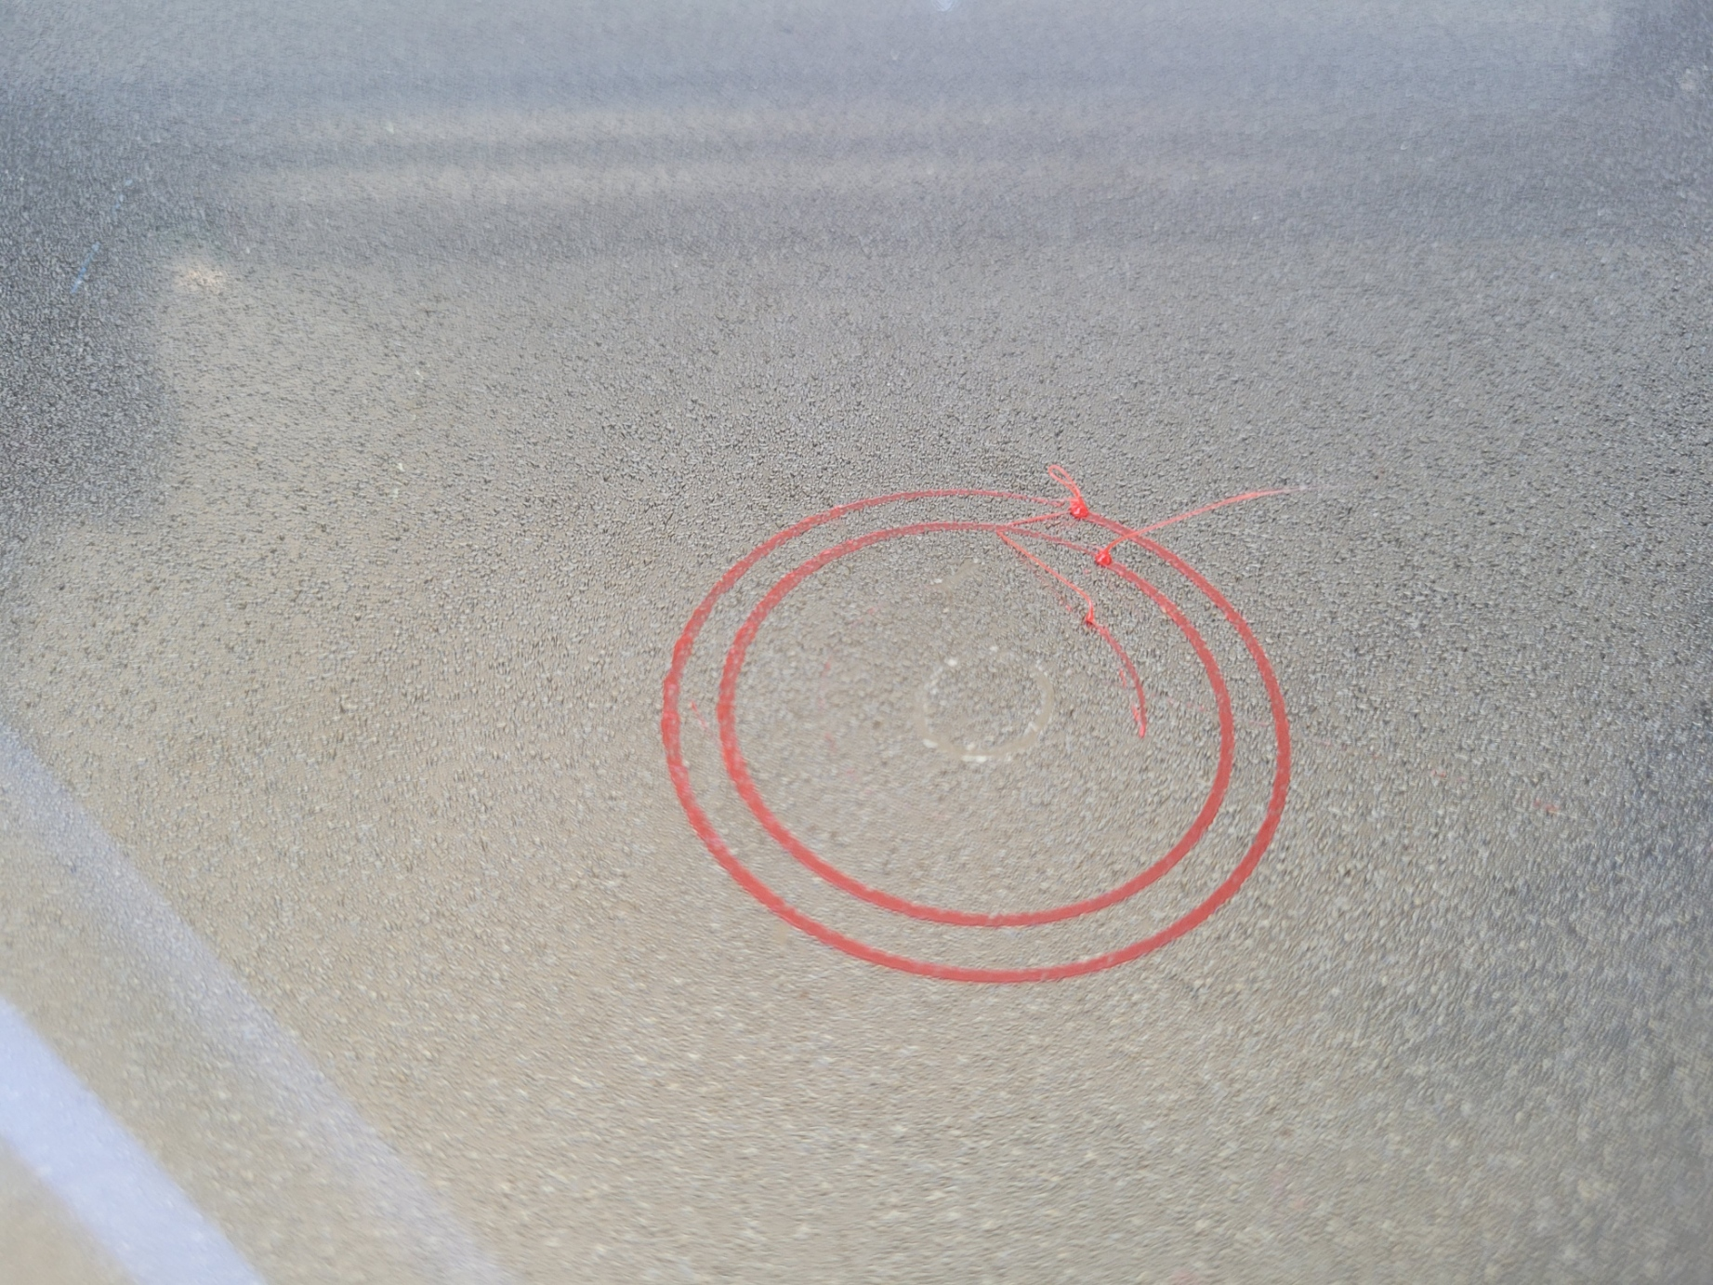
4/6/2022
When extrusion set to relative
Extrusion w/ 5x multiplier. Blobs at end of each curve

Slide 7
4/6/2022 Thoughts
The work and upload process is very convenient, feedback loop is much tighter from making small edits to printing
Extrusion multiplier/equation probably needs to be tweaked since a 5x multiplier gets me close to normal extrusion
First extrusion command before any tool selected will throw error. Possible to remove this?
Is it possible to do a relative extrusion to make it more consistent with other slicers? This is low priority though
Is there any option for extrusion retraction as well? To prevent blobs at end of each extrusion curve

Slide 8
Running To-Dos
Try one layer, tool switching
Workflow for that and seeing how I combine the gcode for each/how I’d like to do it
More consideration of my order of operations
Try a two or three layer thing
Try some interesting infills

Slide 9
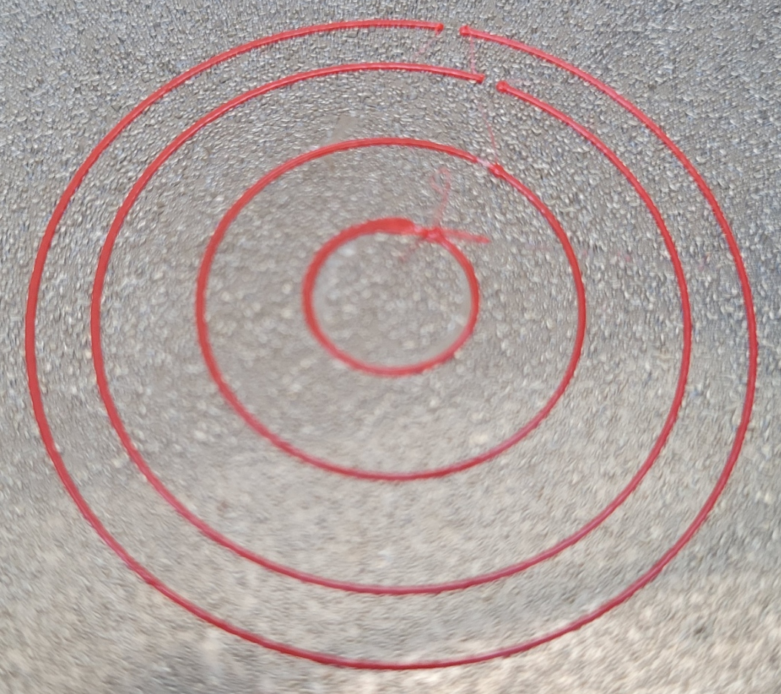
4/18/2022 - Circles
Updated Vespidae and trying to rerun the Circle code
Having relative extrusion is nice! Also maybe just in my head, but makes the extrusion seem smoother
There looks like a disconnect between the start and end point of each curve.
Hard to pinpoint whether it’s the start or end point that’s causing the issue, so will try with squares

Slide 10
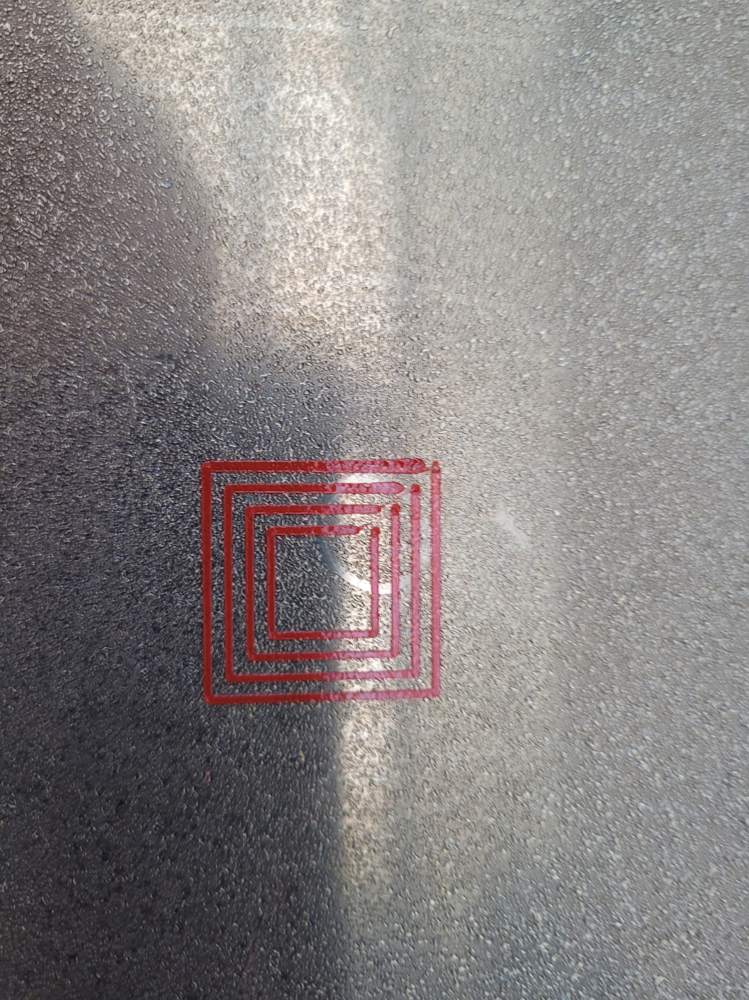
4/18/2022 - Squares
Starting Corner
From the squares, it looks like the beginning is the part that’s not being printed
Might be because the first command is E0? Even though that’s technically just the start of the curve anyways.
There’s probably some need for some priming before each print curve and some retraction at the end of each curve to prevent any blobbing.

Slide 11
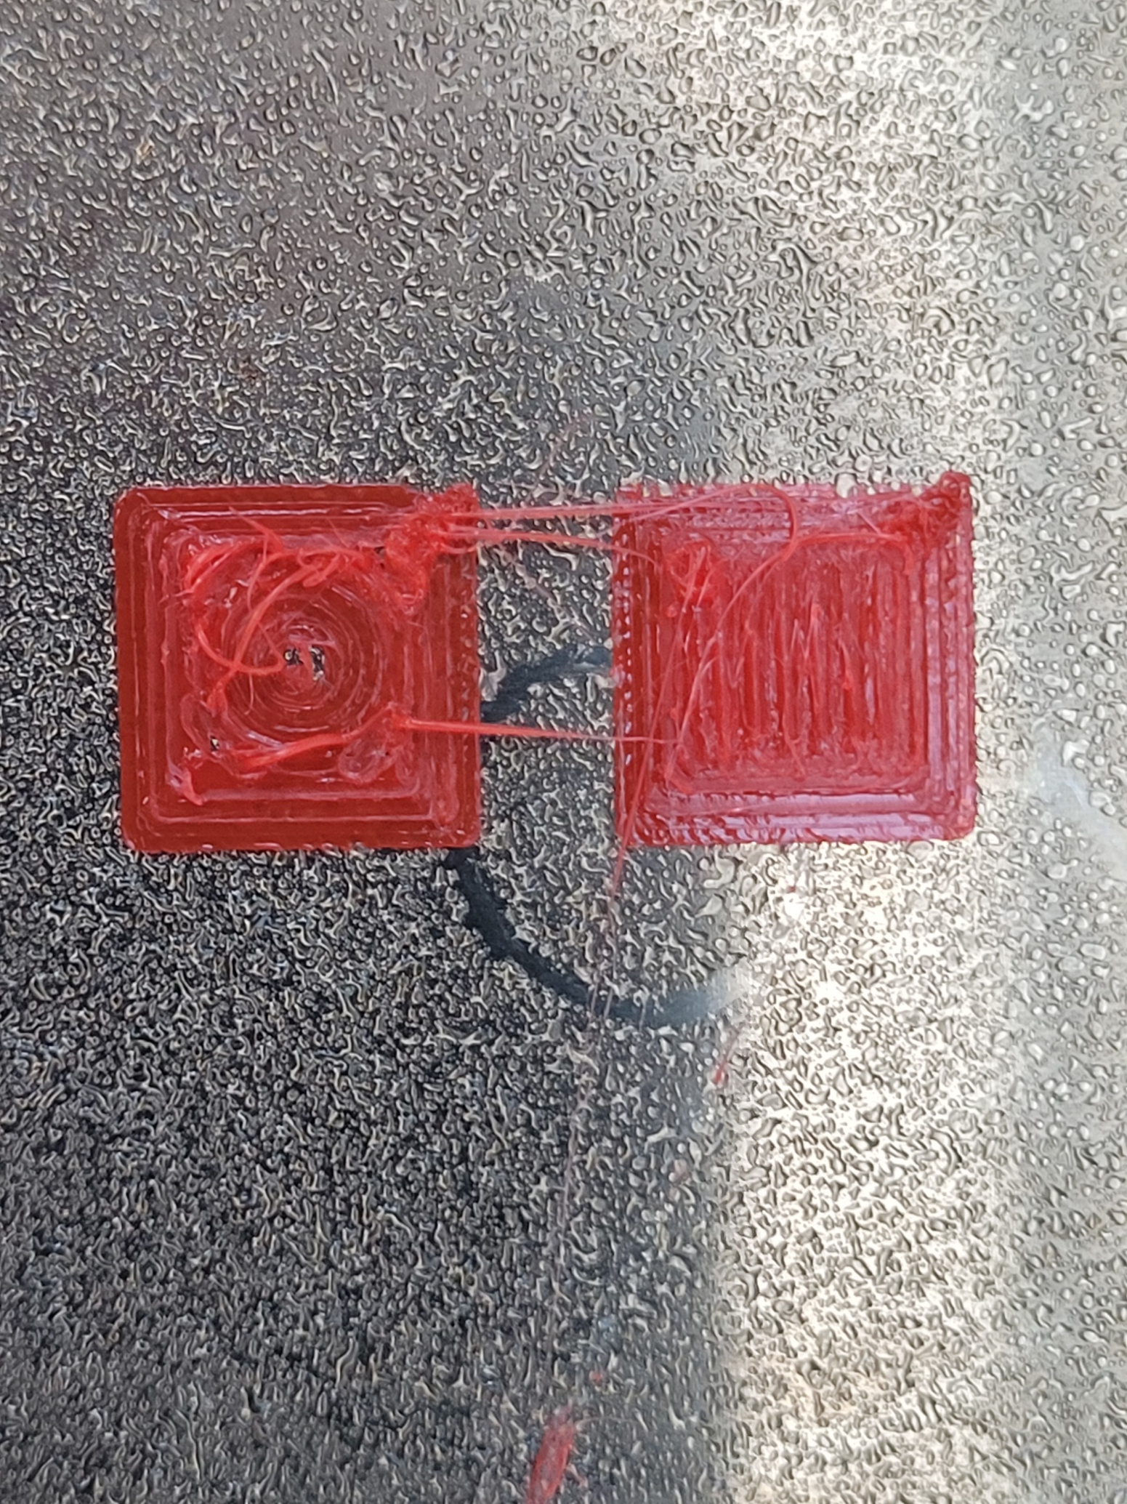
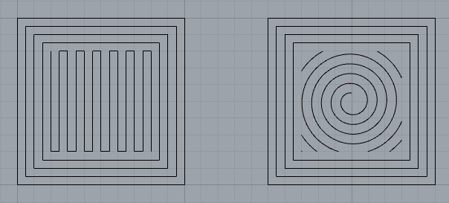
04/18/2022 – Infill Square
Potential first layer of a battery, playing around with infill patterns
The pieces of the spiral pattern broke the visualize paths option, saying that an object reference not set to an instance of an object
I’m mostly arbitrarily determining line spacing & extrusion rates right now, so having an infill function for each layer would be helpful

Slide 12
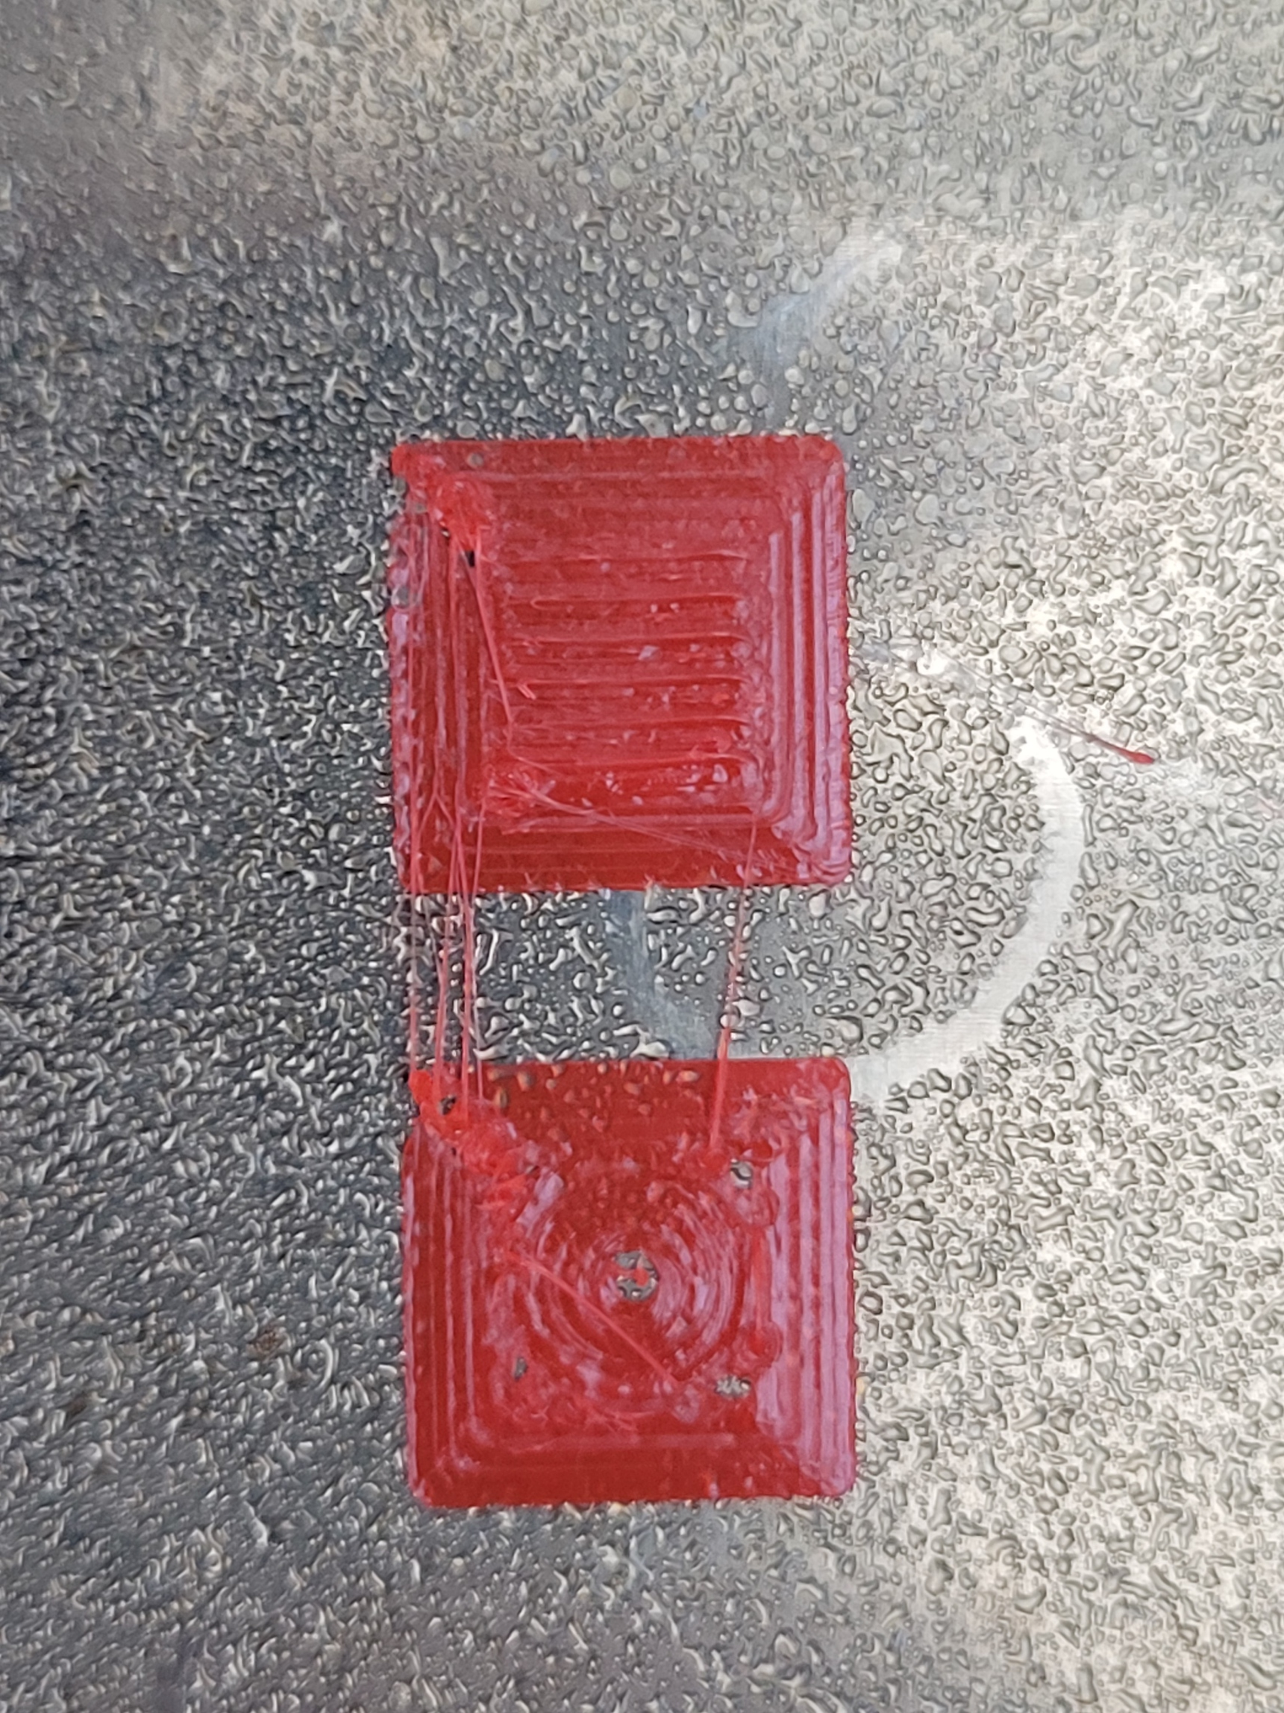
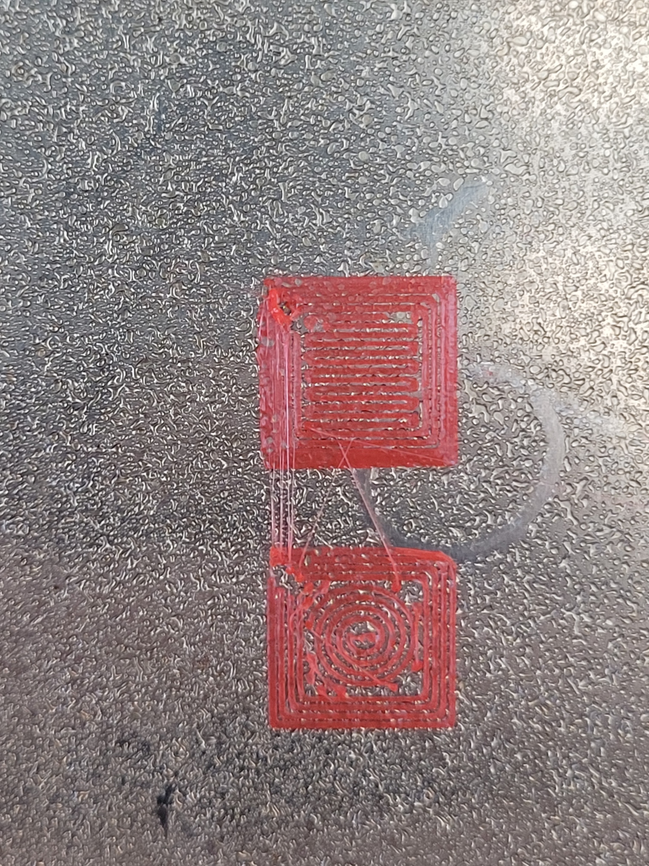
04/18/2022
Playing around with extrusion factors
I’m actually getting things with more normal extrusion factors now, which I wasn’t before. I’ll start using more standard ones going forward
Extrusion Factor: 4
Extrusion Factor: 1.5

Slide 13
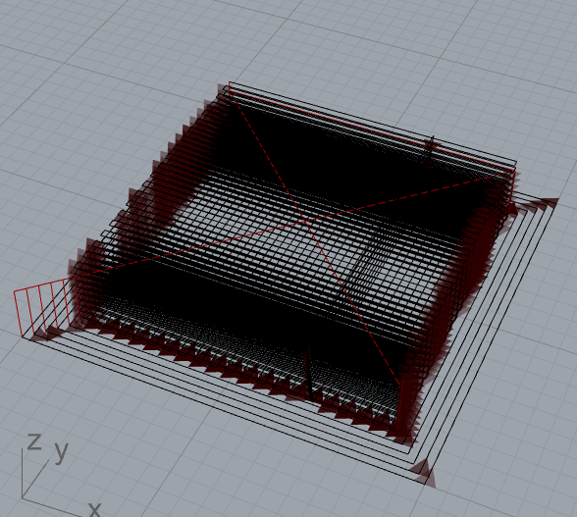
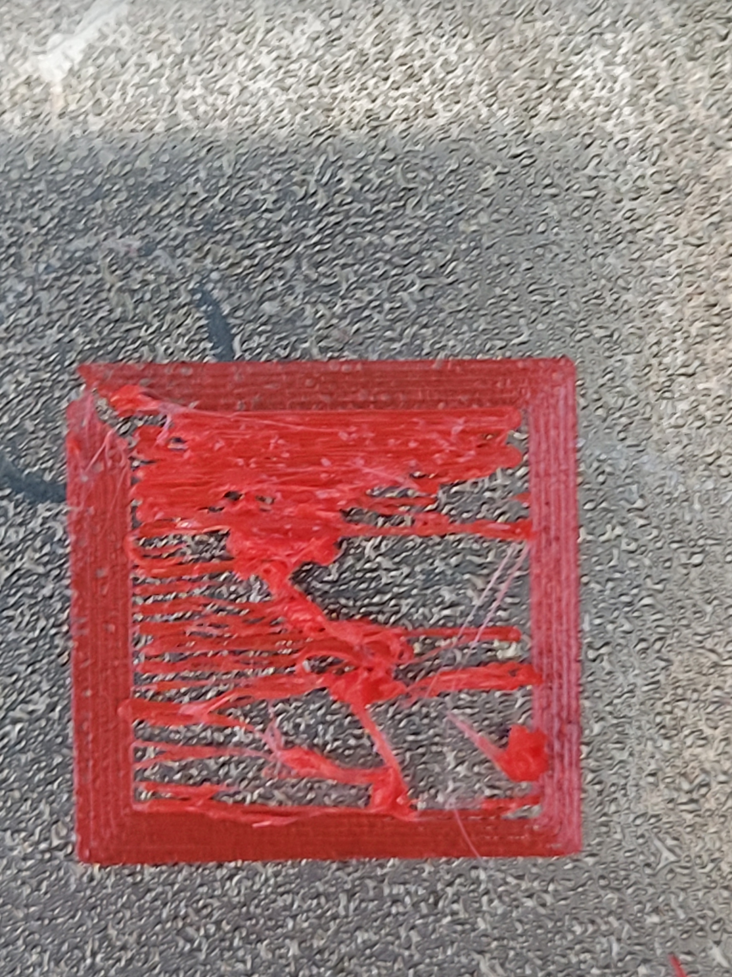
04/18/2022 – Infill Tower
Made toolpaths with changing Z-positions now
Currently troubleshooting first layer, might just be stuffing too many lines in?

Slide 14
4/18/2022 Thoughts
What does the G Code Inject do/how is that different from the header/footer g-code?
Some sort of prime before printing each curve looks like it could be helpful in making continuous prints, and a retract would help with the blobs and stringing seen between each curve
Retract is especially helpful in battery printing to prevent short circuits between different materials
Infill code would be a nice add-on, but I can make do without for now. Handling multi-tools or handling printing of different Rhino layers with different tools is most helpful right now

Slide 15
4/18/2022 – To-Dos
Send Frikk geometry of simpler 3D battery geometry, and a quick diagram of proposed workflow for printing that one
This geometry is made up of lines (looks sort of like a farm field) instead of vertical pillars
Dimensions, especially height, are much different than what I first sent you
Test the infill tower layer print

Slide 16
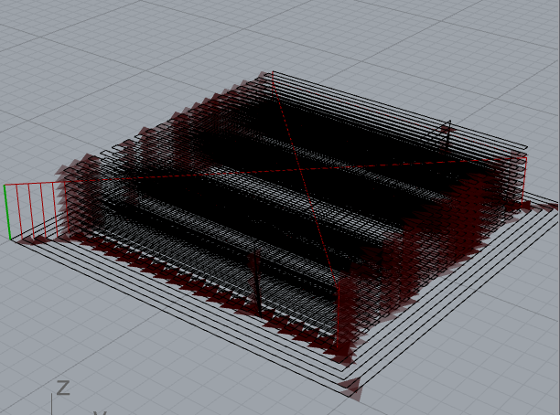
4/19/2022 – Infill Tower
Actually, looking at the CAD, I’m not sure the travel actually goes above the highest piece? So is travel retract an absolute value, or added to whatever Z coordinate is set?

Slide 17
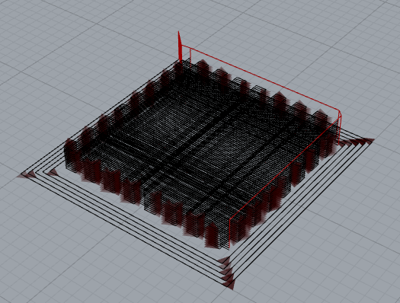
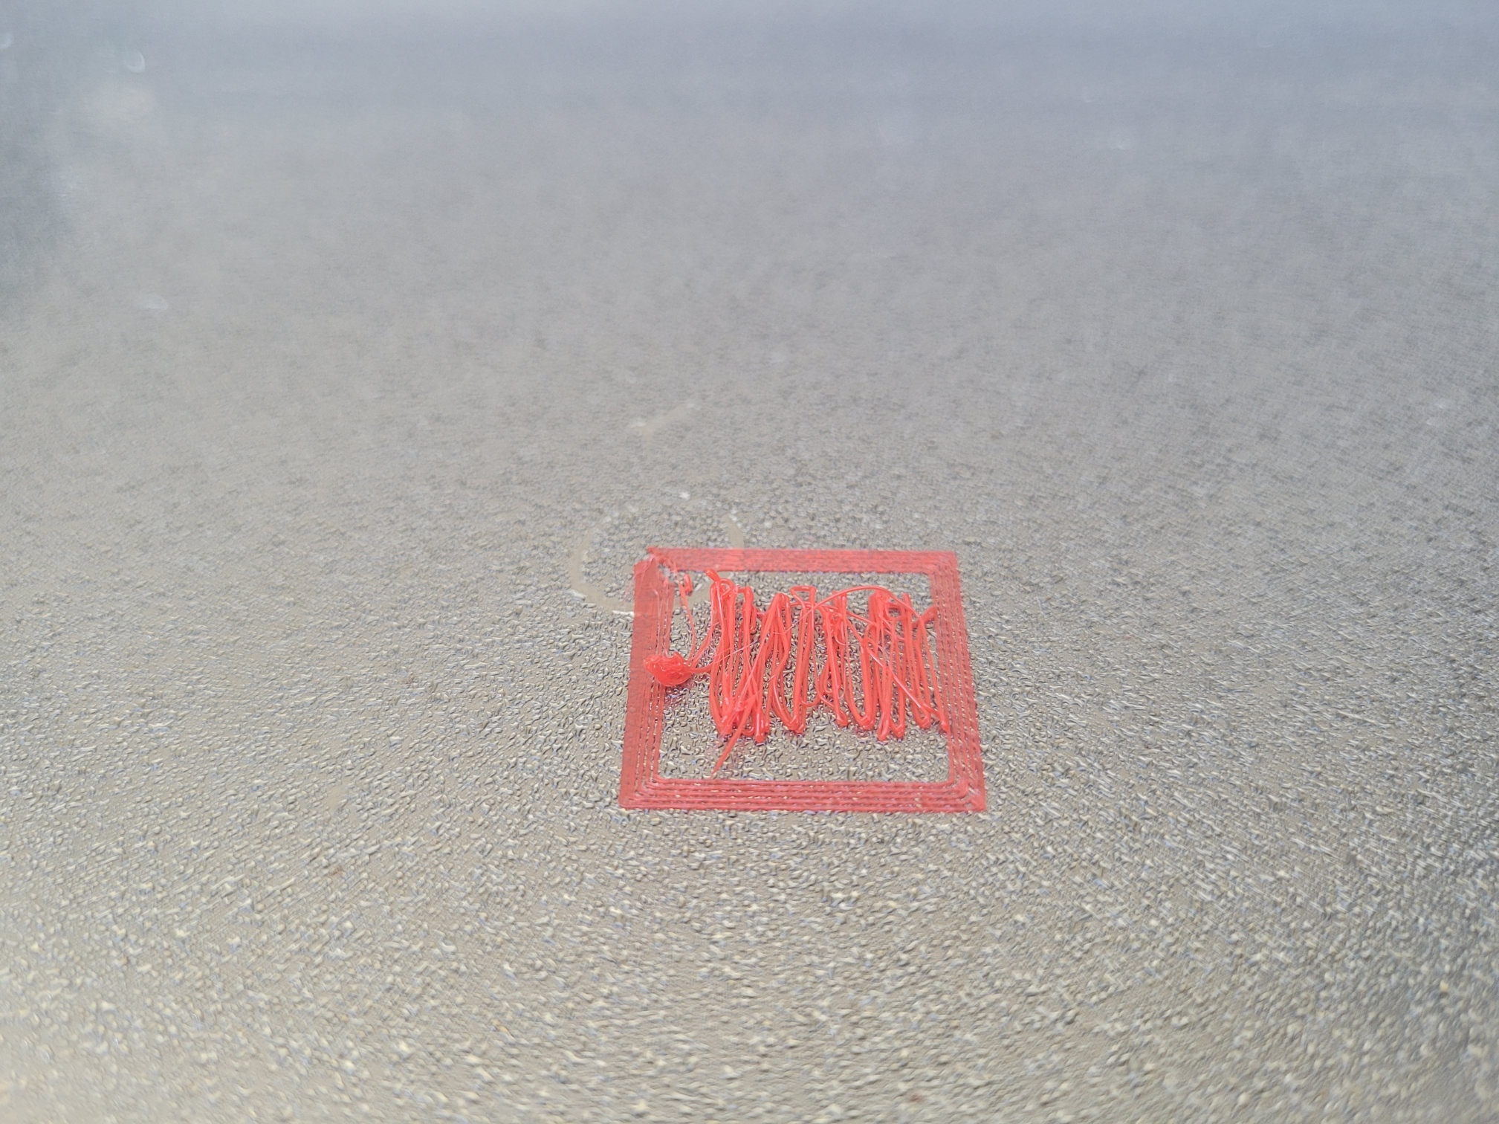
4/19/2022 – Infill Tower
Adjusted tower to have more spacing so that it wouldn’t clump up and make a mess. The sorting of this new version seems to want to go top-to-bottom instead of bottom-to-top. You can see this in the visualize path if you use the slider.
The sorting wants to do all the infills in one direction going top down, then the infills in the perpendicular direction going top down.
Default sorting priority:
Z (bottom up)
X/Y
Maybe that’s not necessarily true for multi tool though

Slide 18
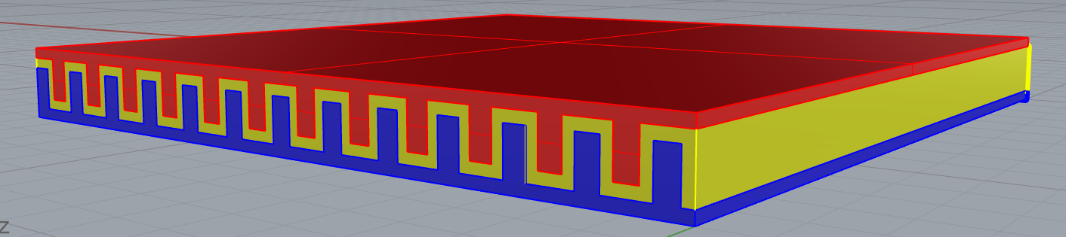
04/19/2022 – Battery Design
Line/Trench Battery Design
Separator (Yellow) should be thin as possible, so thinking of printing that as the last layer of every Z layer, minimize extrusion factor so that it kind of just seeps into remaining gaps
Will throw together a layer by layer example soon

Slide 19
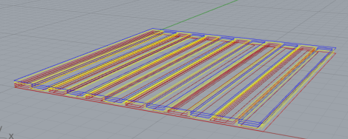
05/10/2022 – Battery Toolpaths w/ new build
Sorry it’s taken so long to get back to it!
Following up on the Line/Trench Design of previously, I made some approximate toolpaths
The goal here is to infill the rectangular curves and there are also some single-line curves for the yellow
Would test out the new infill part &
the multi-tool functionality
Perspective
Side View

Slide 20
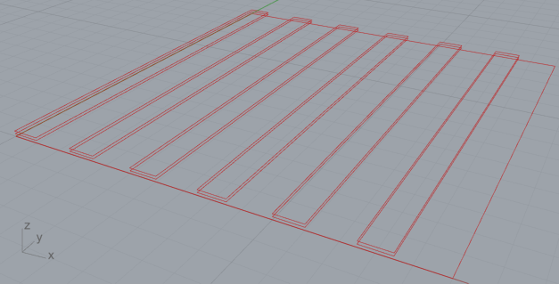
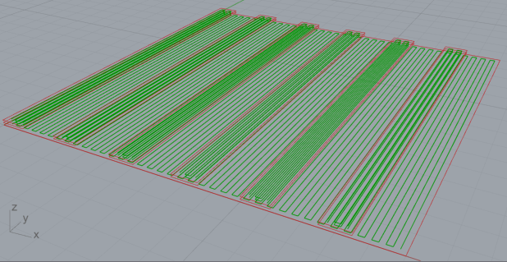
05/10/2022 – Battery Toolpaths
Looking at just the anode for now, the infill part looks good to me, makes what I was expecting
I need to take a better look at what the infill density calculates. Setting it really high (3) leaves a single line for the thin rectangles that is on the left edge. Maybe it should be in the middle? But also I don’t think I’ll ever print at that high a density so it probably doesn’t matter.

Slide 21
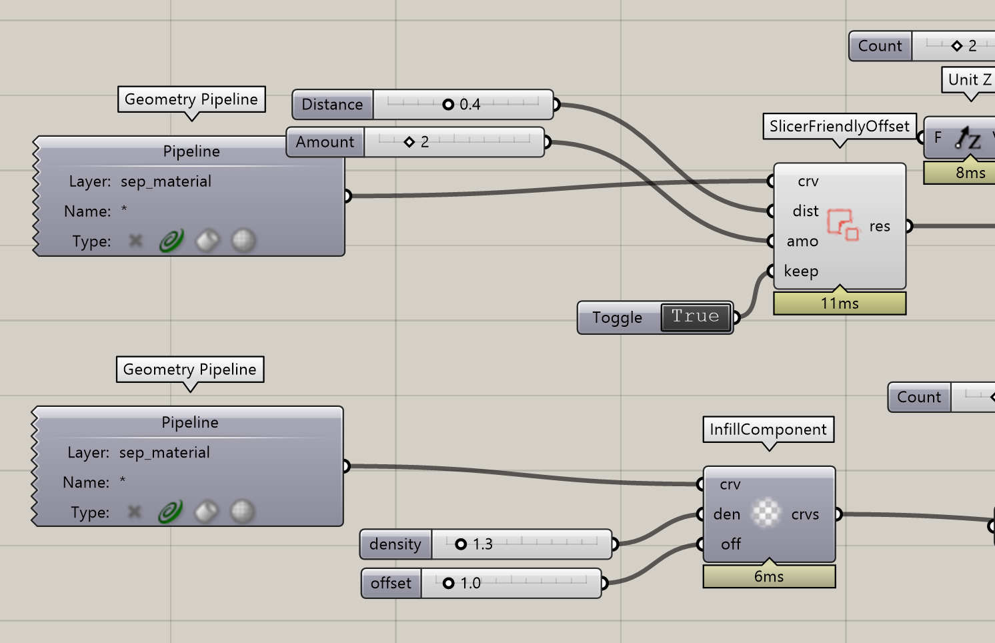
05/10/2022 – Quick Thoughts about Infill
Quick thoughts about infill
It might speed up setting up a workflow to add the offset logic into the infill package. That way in the infill component you can set your infill density, your shells, and the distance of your shells.
That way you won’t have to worry about calculating your offsets correctly. It will automatically set your offset from the innermost shell.

Slide 22
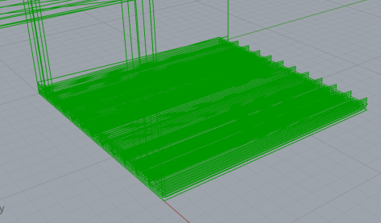
05/10/2022 – Battery Toolpaths
Expanded what I did to for all three layers
Tried to visualize and it is now obvious to me that complicated things become harder to visualize. Going through the list of curves still works perfectly fine though!
Reminds me that I still need to
follow up w/ Jasper.
I should go back to simpler
geometries for testing purposes

Slide 23
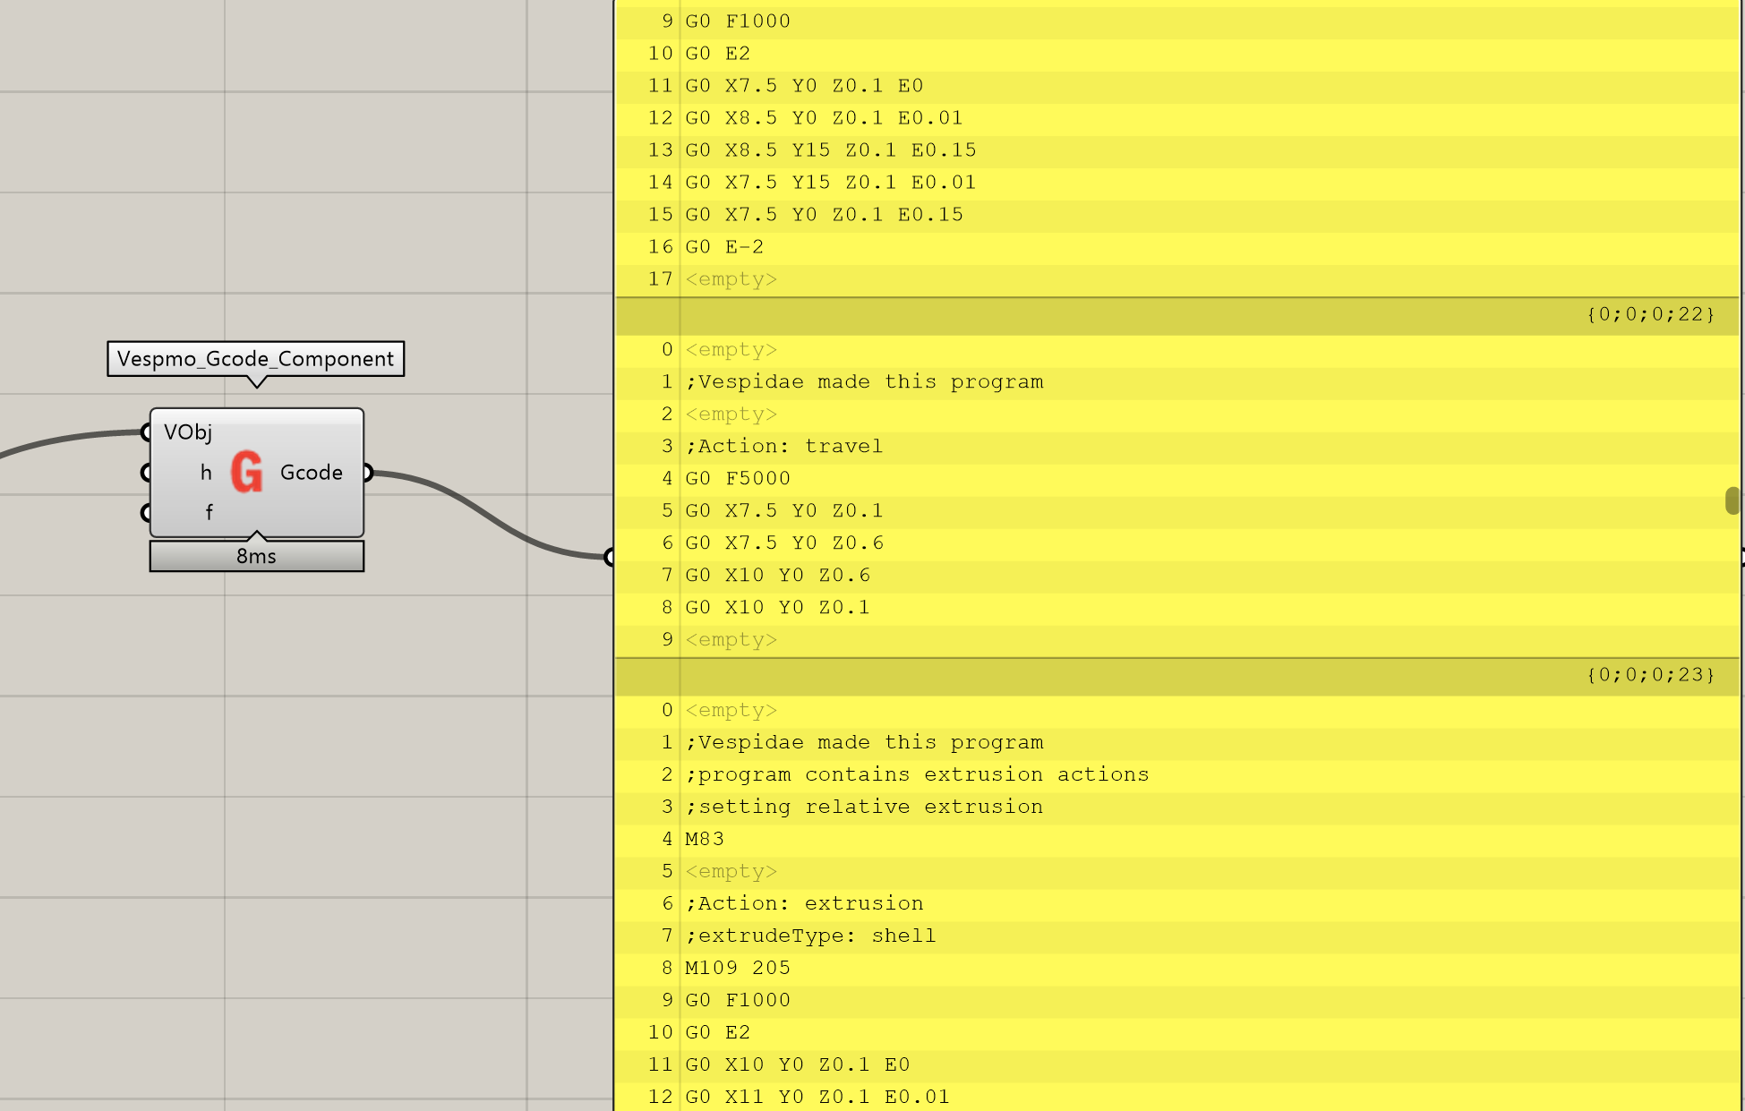
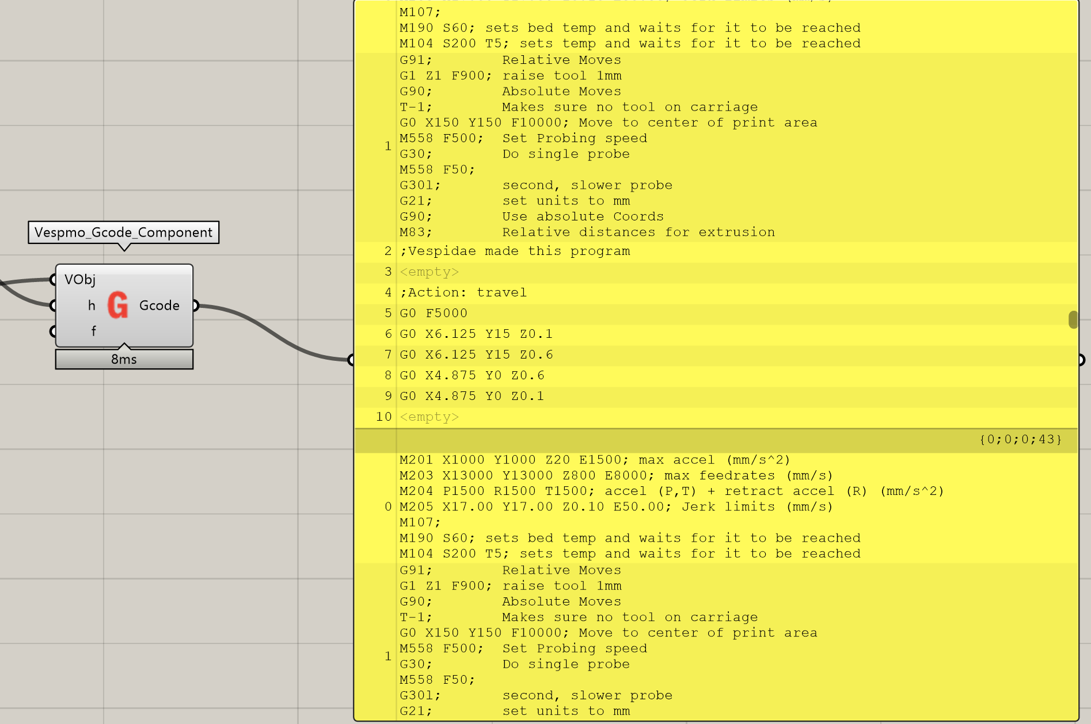
05/10/2022 – Battery Toolpaths G-Code
It looks like Grasshopper’s data trees are being a pain
It breaks each shell & infill into a branch, but then the Gcode component adds my custom header to each branch
Maybe this component needs to flatten everything before adding headers? Looks like that works, but unsure if it messes up any of your planned workflows internally

Slide 24
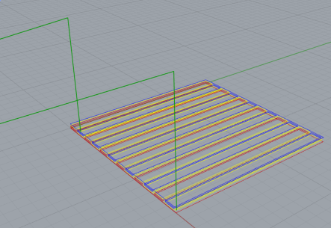
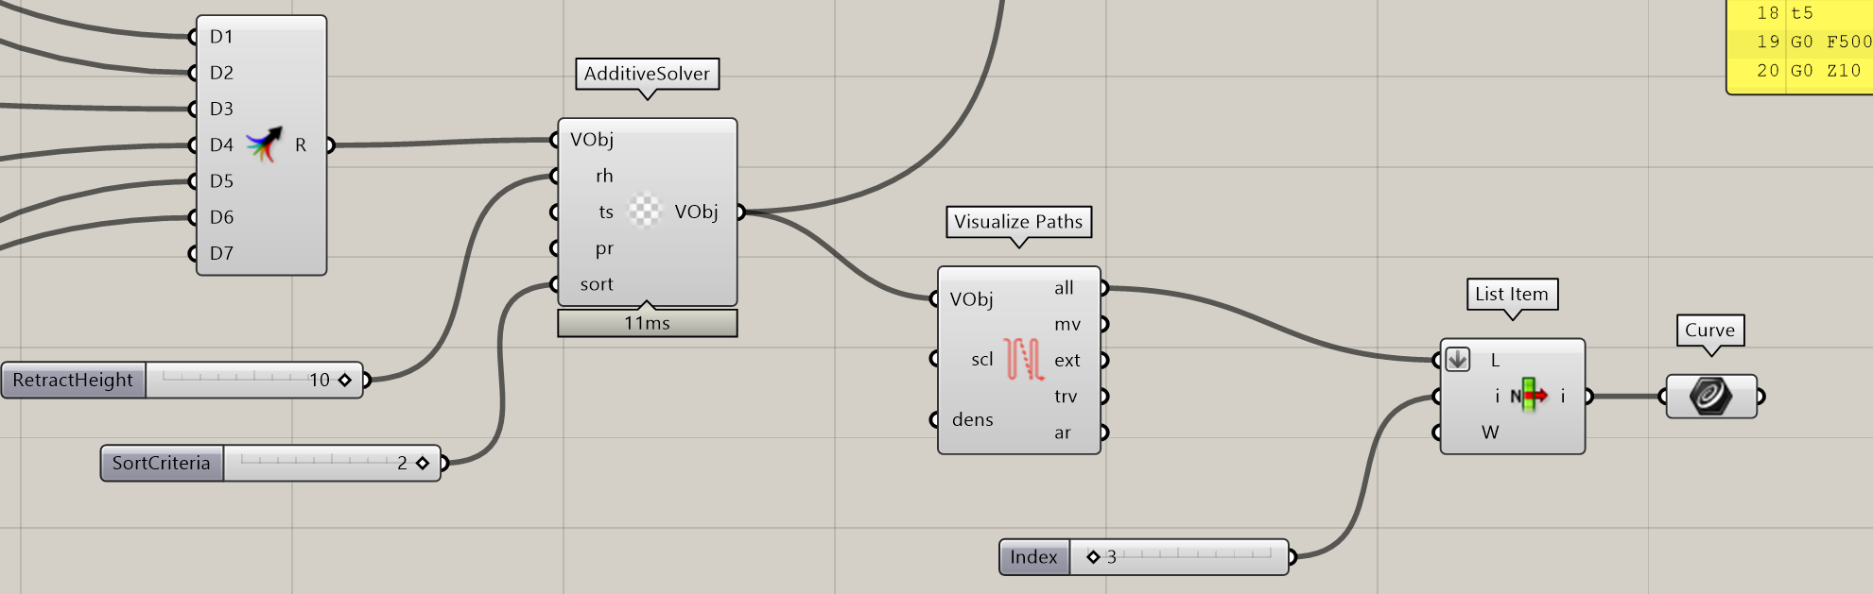
05/10/2022 – Battery Toolpaths Sorting
I’m not sure the sorting component of AdditiveSolver is sorting by tool? Actually it might be sorting by tool if it sorts by number
I think what I was imagining by sort by tool is that either I could set the order somewhere or I could sort to minimize toolchanges. So since it ended last layer w/ tool5, it would start the next layer w/ tool5

Slide 25
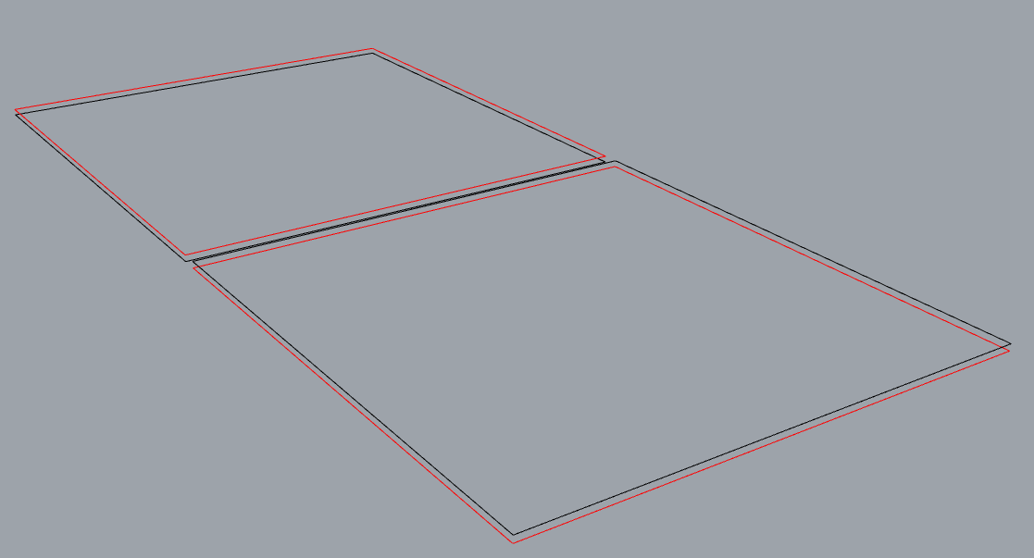
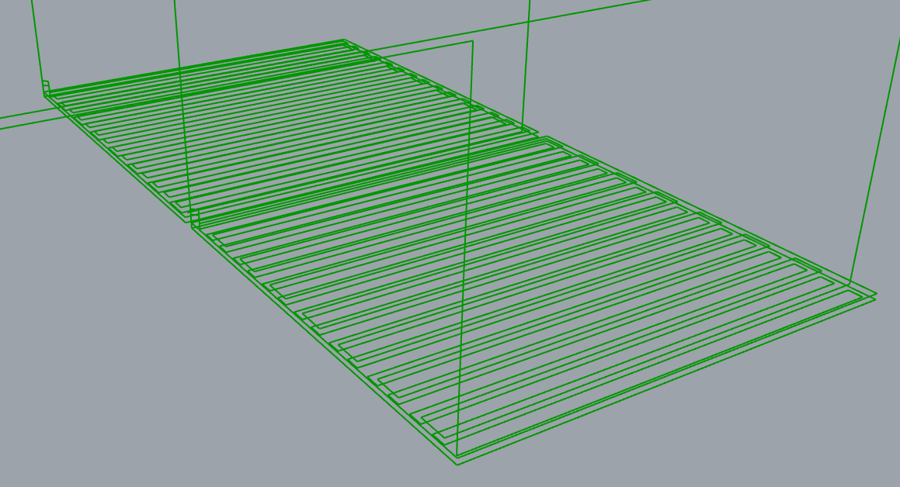
05/12/2022 – Simple Multitool
Made a 2 layer, 2 tool geometry so I can actually tell what’s going on
Per conversation w/ Frikk, realized that I need to flatten all the curves in Grasshopper before I input it into the Additive Solver, or else the order of operations will be messed up

Slide 26
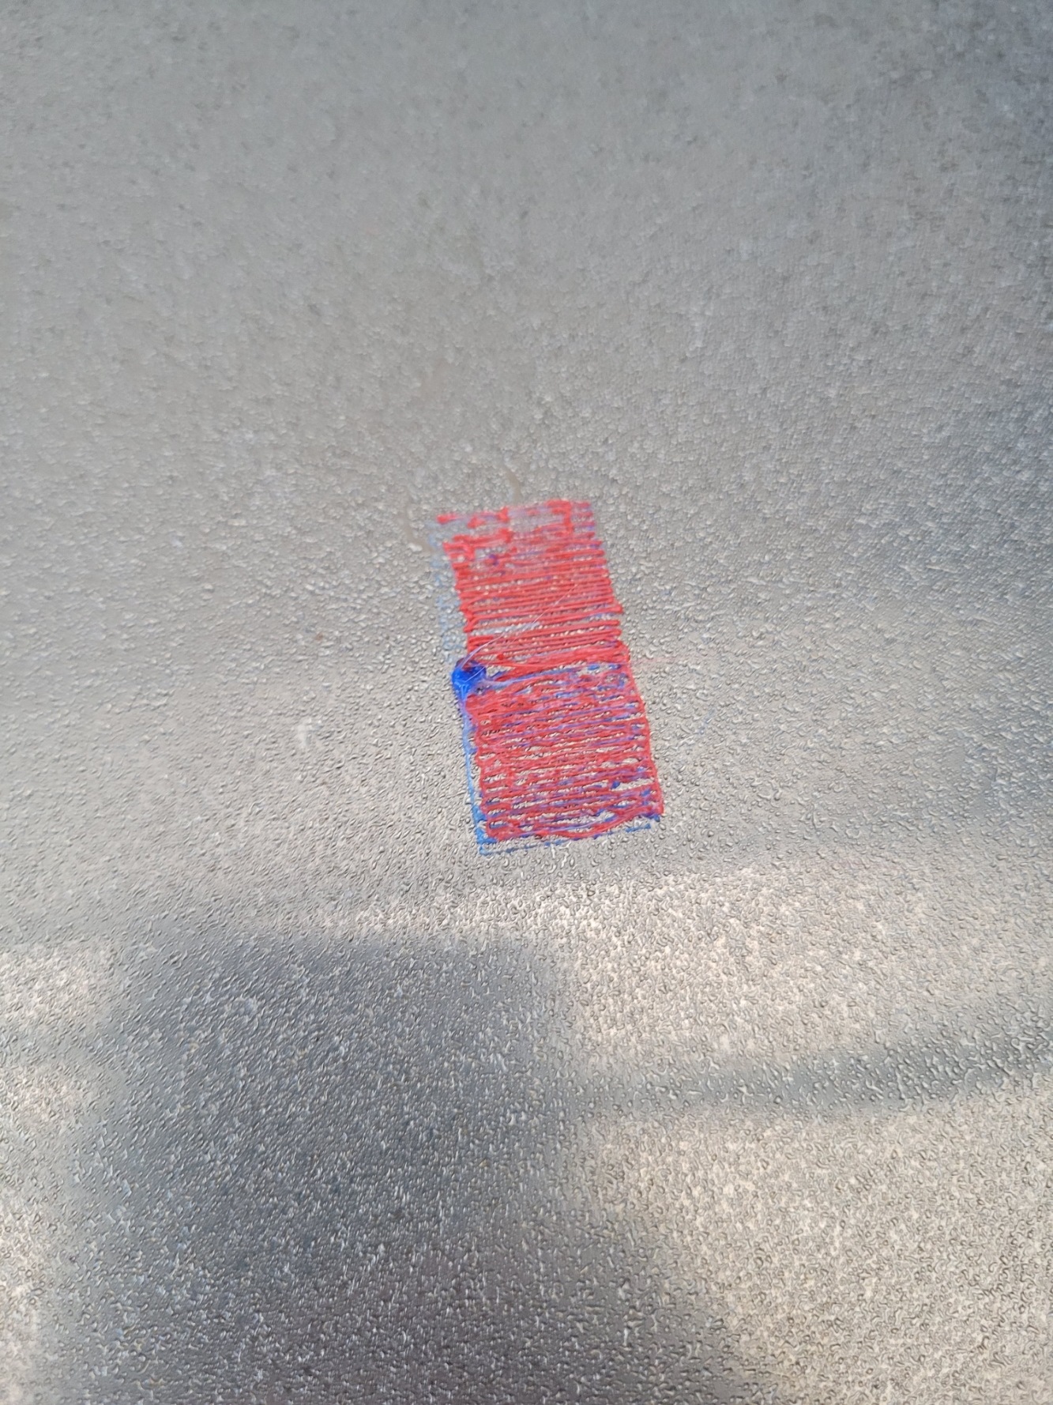
05/12/2022 - Simple Multitool
Movement went as expected! No problems with toolchanging either
The end result is not very pretty, but it looks like an extruder issue with blue, and still need to work out the right extruder multiplier I think. I’ll also maybe print a bigger thing next time.

Slide 27
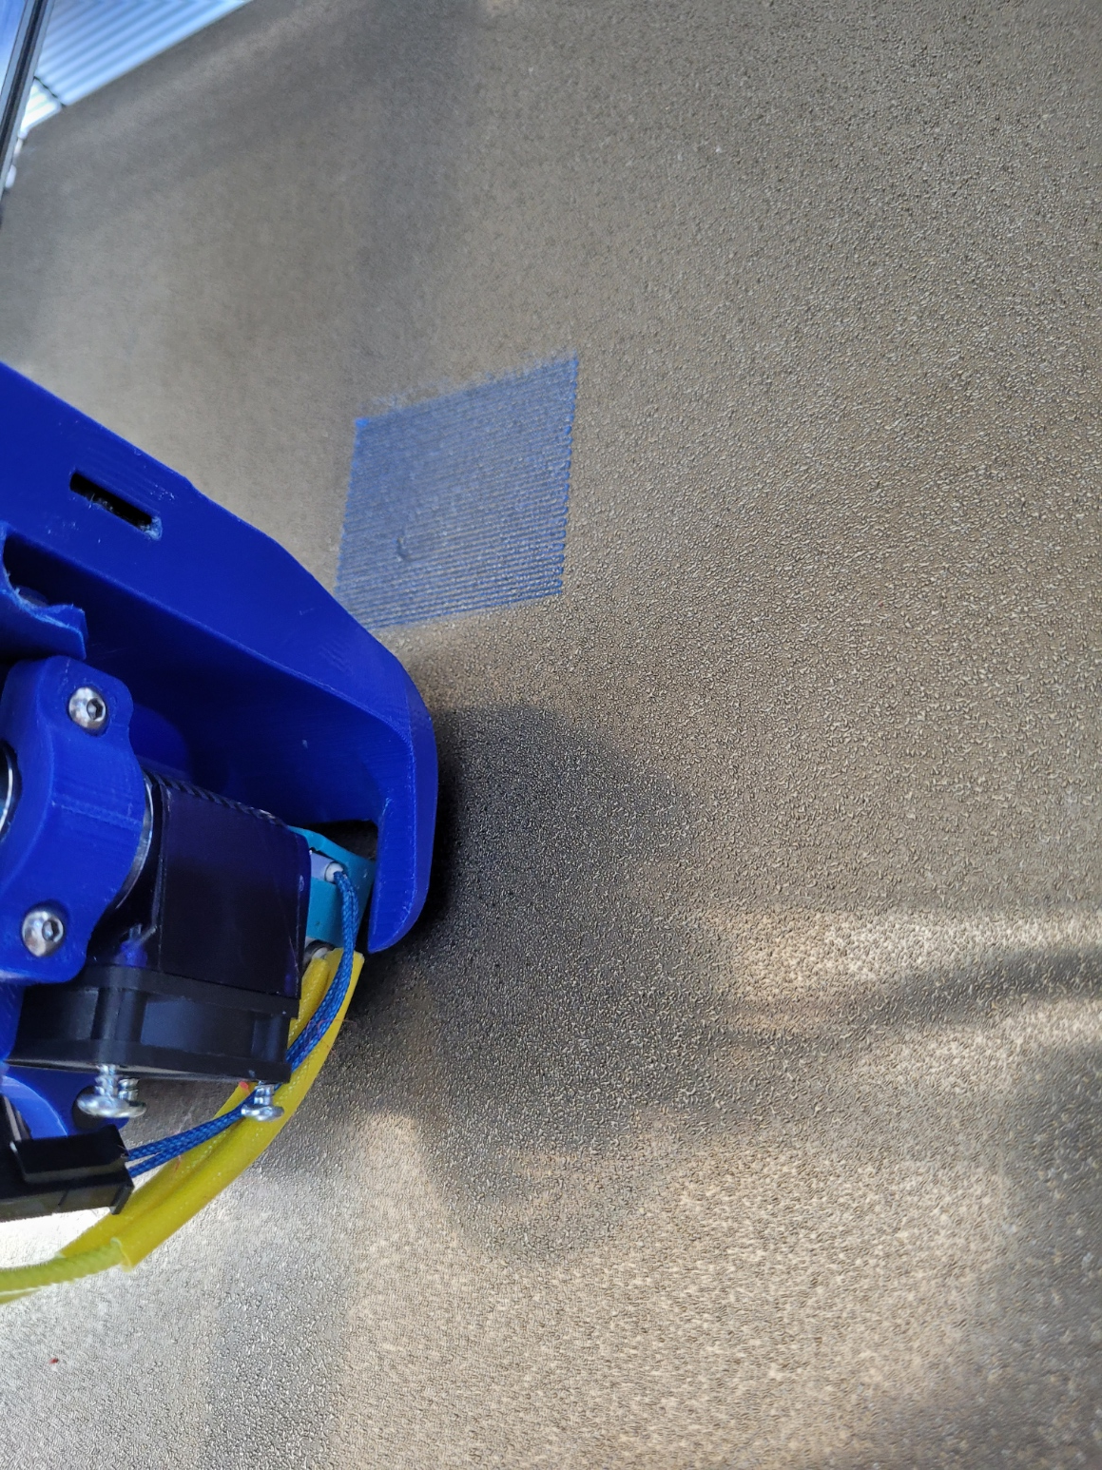
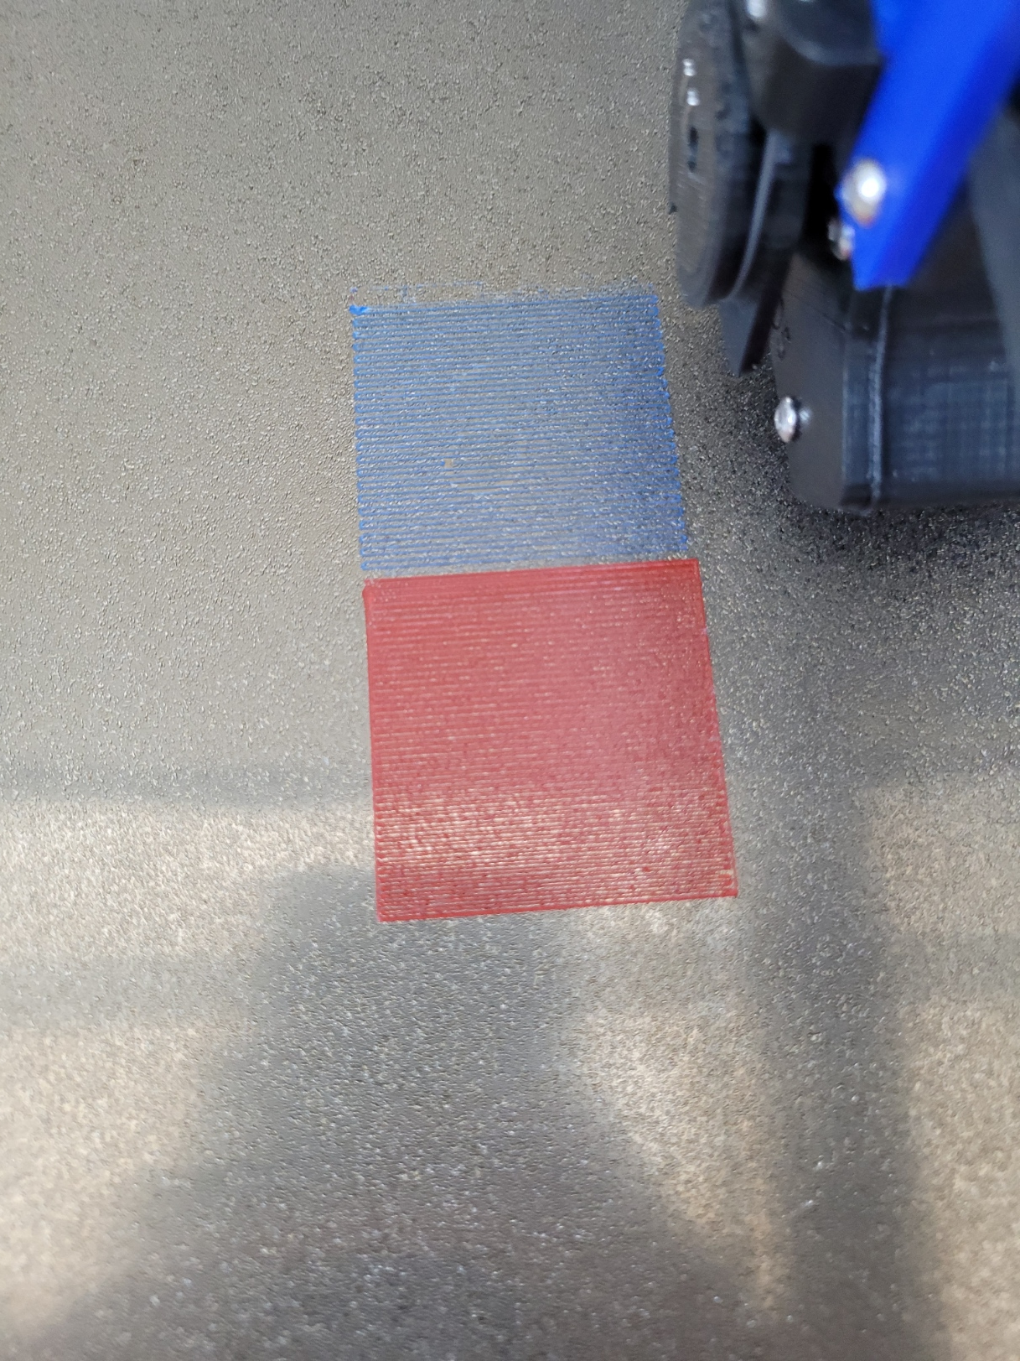
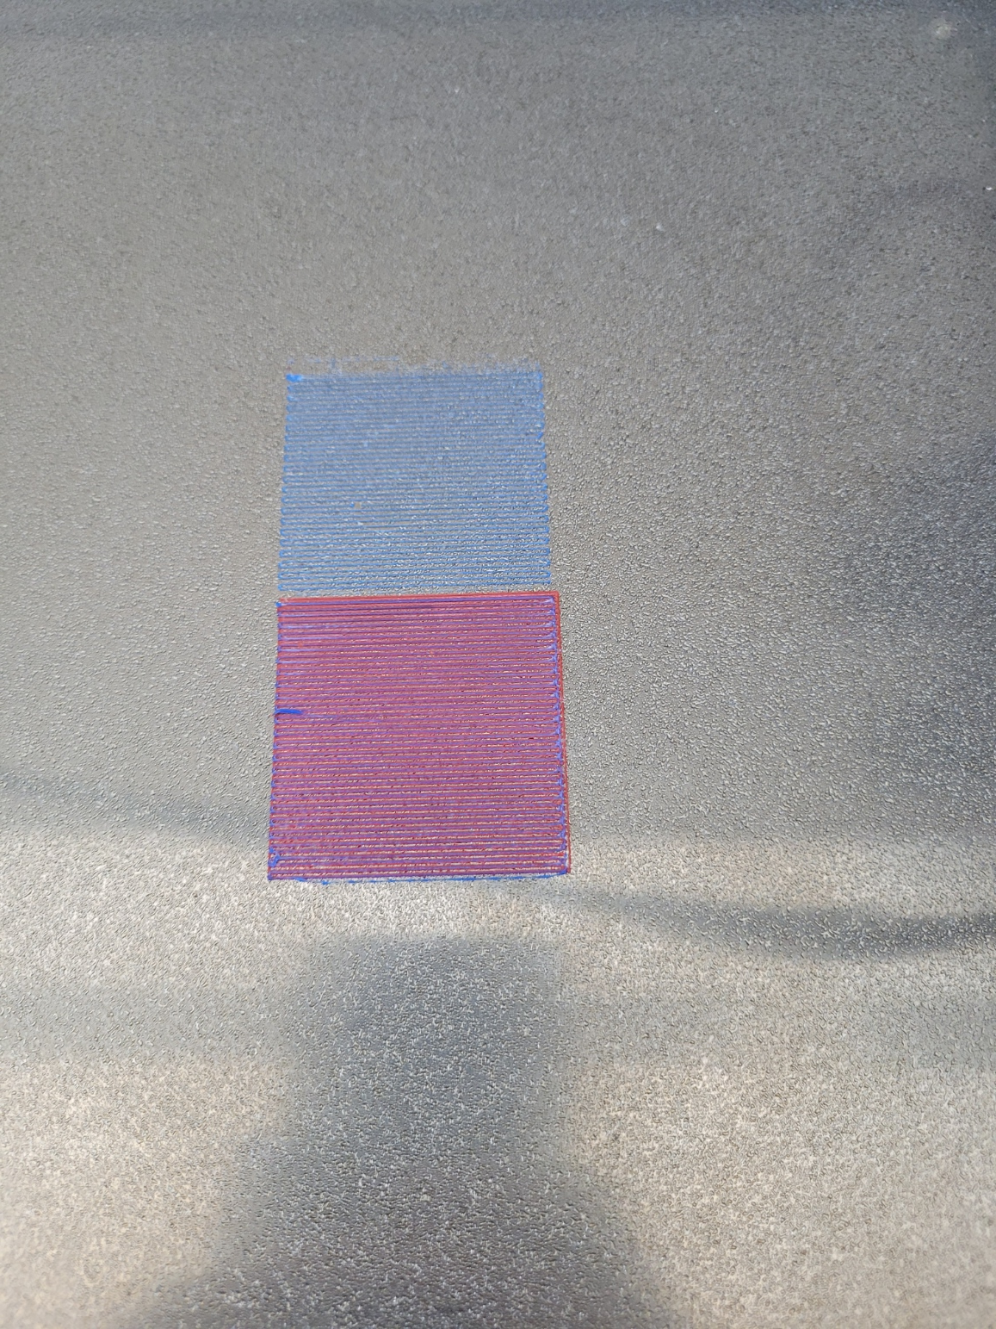
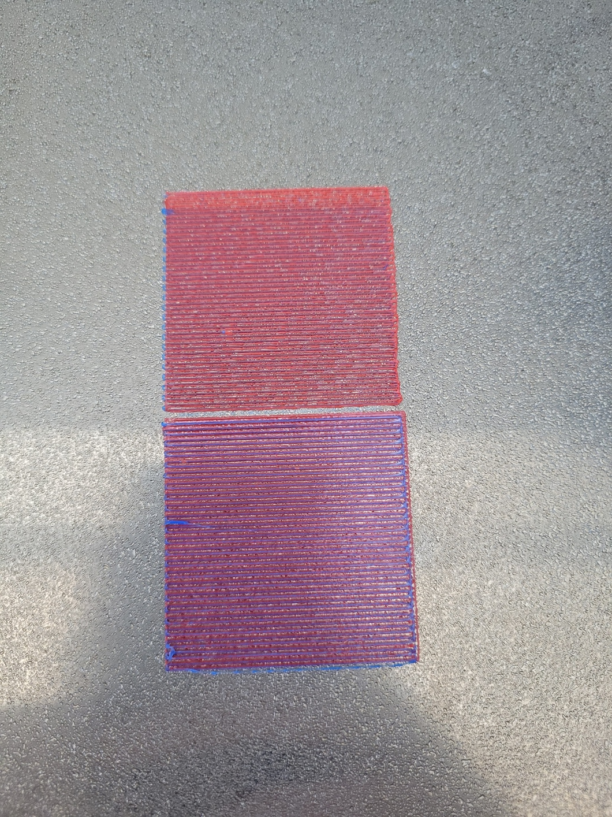
05/24/2022 – Simple Multitool Update
I’m back! I redid the alignment and calibrations for the Jubilee tools. I also made the sample pattern bigger so that it’s easier to see. Red and blue have different infill densities as well, just because I was curious about how that works. Overall, looks pretty good!

Slide 28
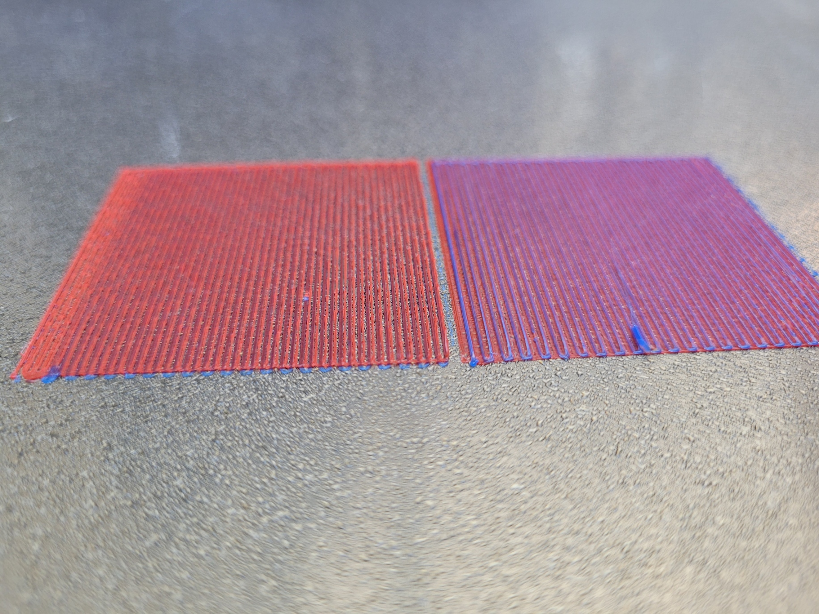
05/24/2022 – Simple Multitool
Tool switching performed as expected
Hard to see in photos, but by eye you can see the differences in infill density
Moving forward I’ll be trying to stack things up a little bit more to get solid infills and more height

Slide 29
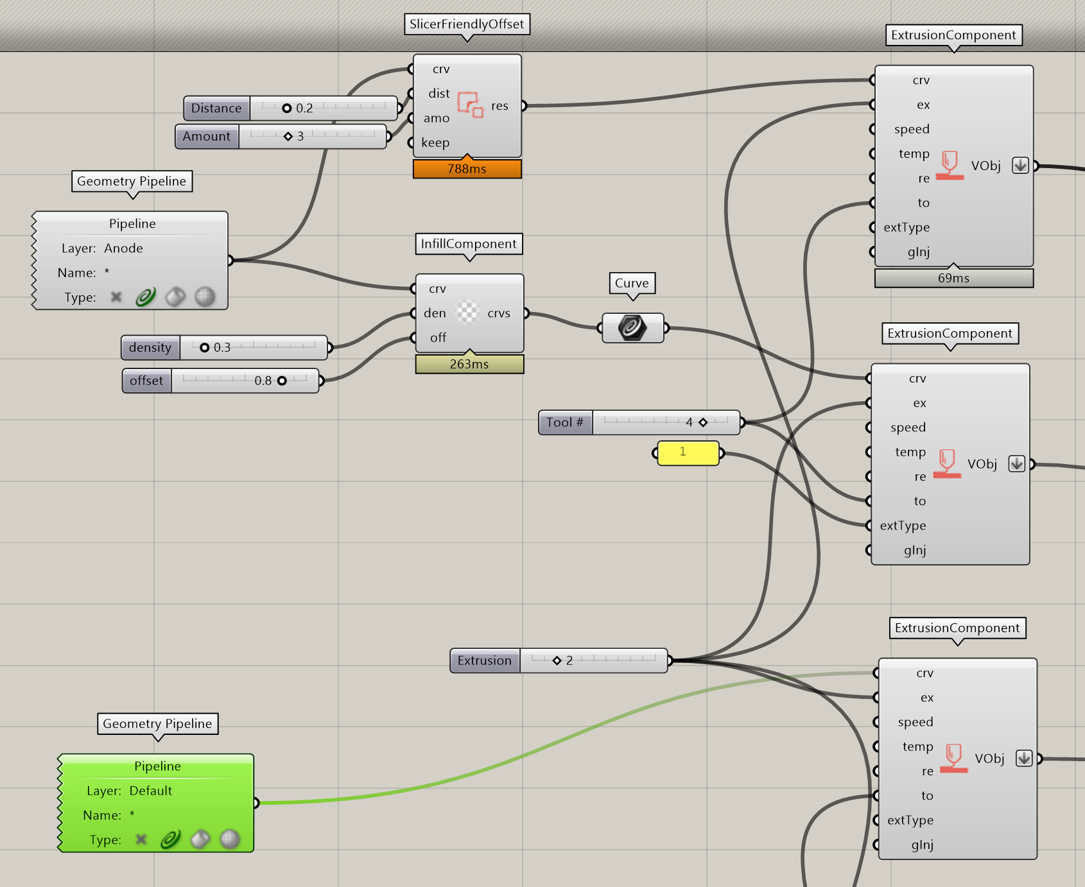
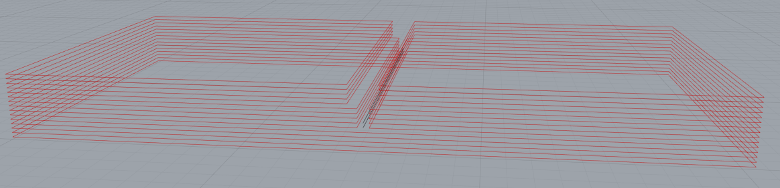
05/26/2022 – 3D Multitool
Expanding the tests, greater number of layers, multiple curves per layer, and testing the offset option for shells

Slide 30
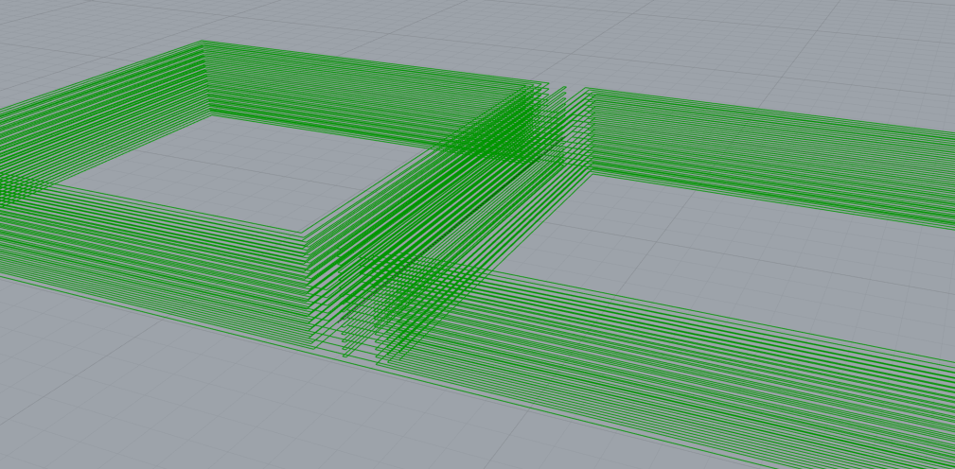
05/26/2022 – 3D Multitool
Had some issues with the slicer offset component. It looks like it makes some curves between the two squares on each layer.
Also it seems to be doing a lot of extra work. Input is 25 layers, but output is 800 layers. Was expecting 75-100. Even when changing amount to 0, outputs 600.

Slide 31
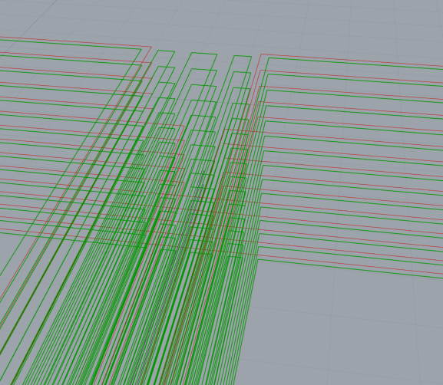
05/26/2022 – 3D Multitool
More looking into the slicer offset. Reduced distance to 0.1 and set “Keep” to false, “amount”=1. Now there are multiple shapes between the curves. 125 results.
Setting keep drastically reduces
number of result curves (700 → 75)
I believe this probably has to do with
what we discussed earlier about how
to figure out what’s an inside vs.
outside polygon?

Slide 32
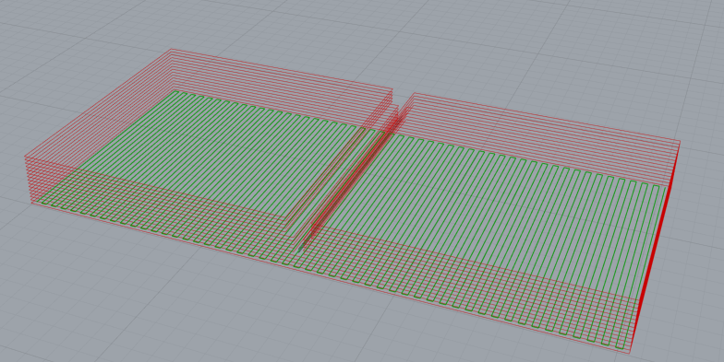
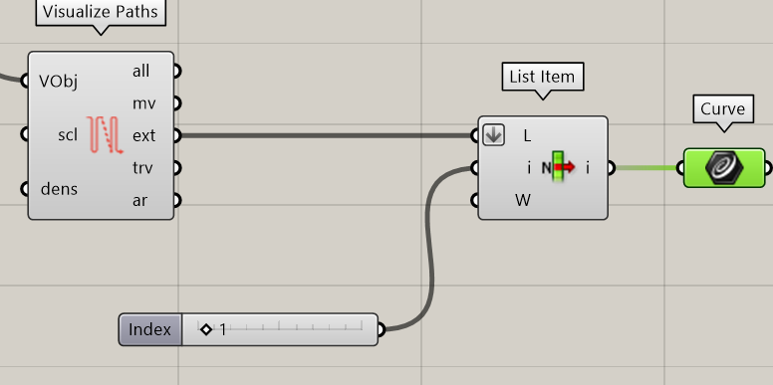
05/26/2022 – 3D Multitool
Tried again without the offset part. Results make more sense and the order of operations is correct.
I’ll probably manually make my shells in the meantime then since that’s low effort on my part.

Slide 33
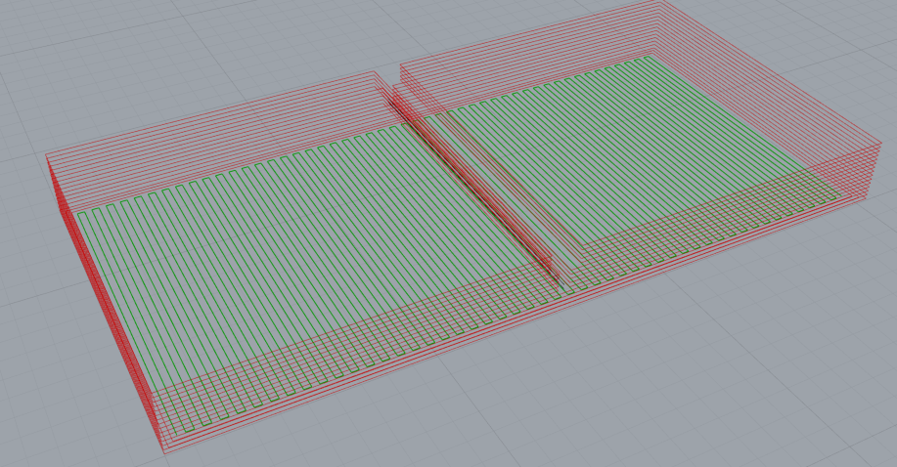
05/26/2022 – 3D Multitool
Made my own shell for the first layer. So far the infill still fills correctly, even with the multiple shells. If I set my offsets greater than the infill density, there’ll be problems, but otherwise this works.
I take that back, it makes an infill for each of those curves so there ends up being 3 different overlapping infills. So for now I’ll work on

Slide 34
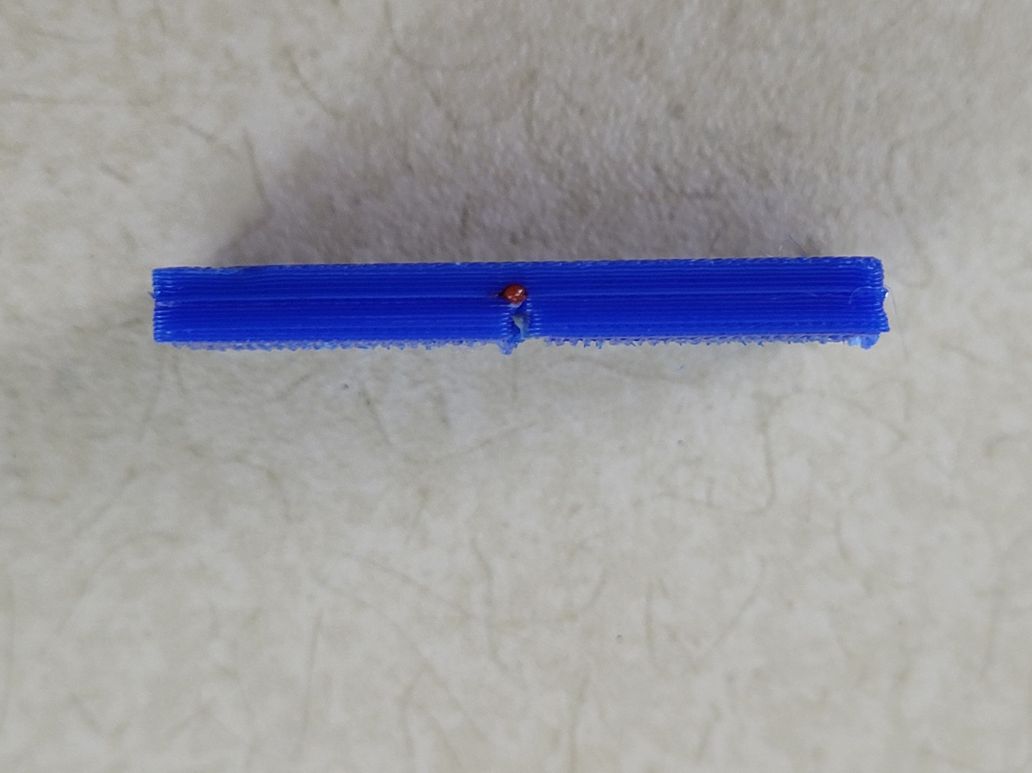
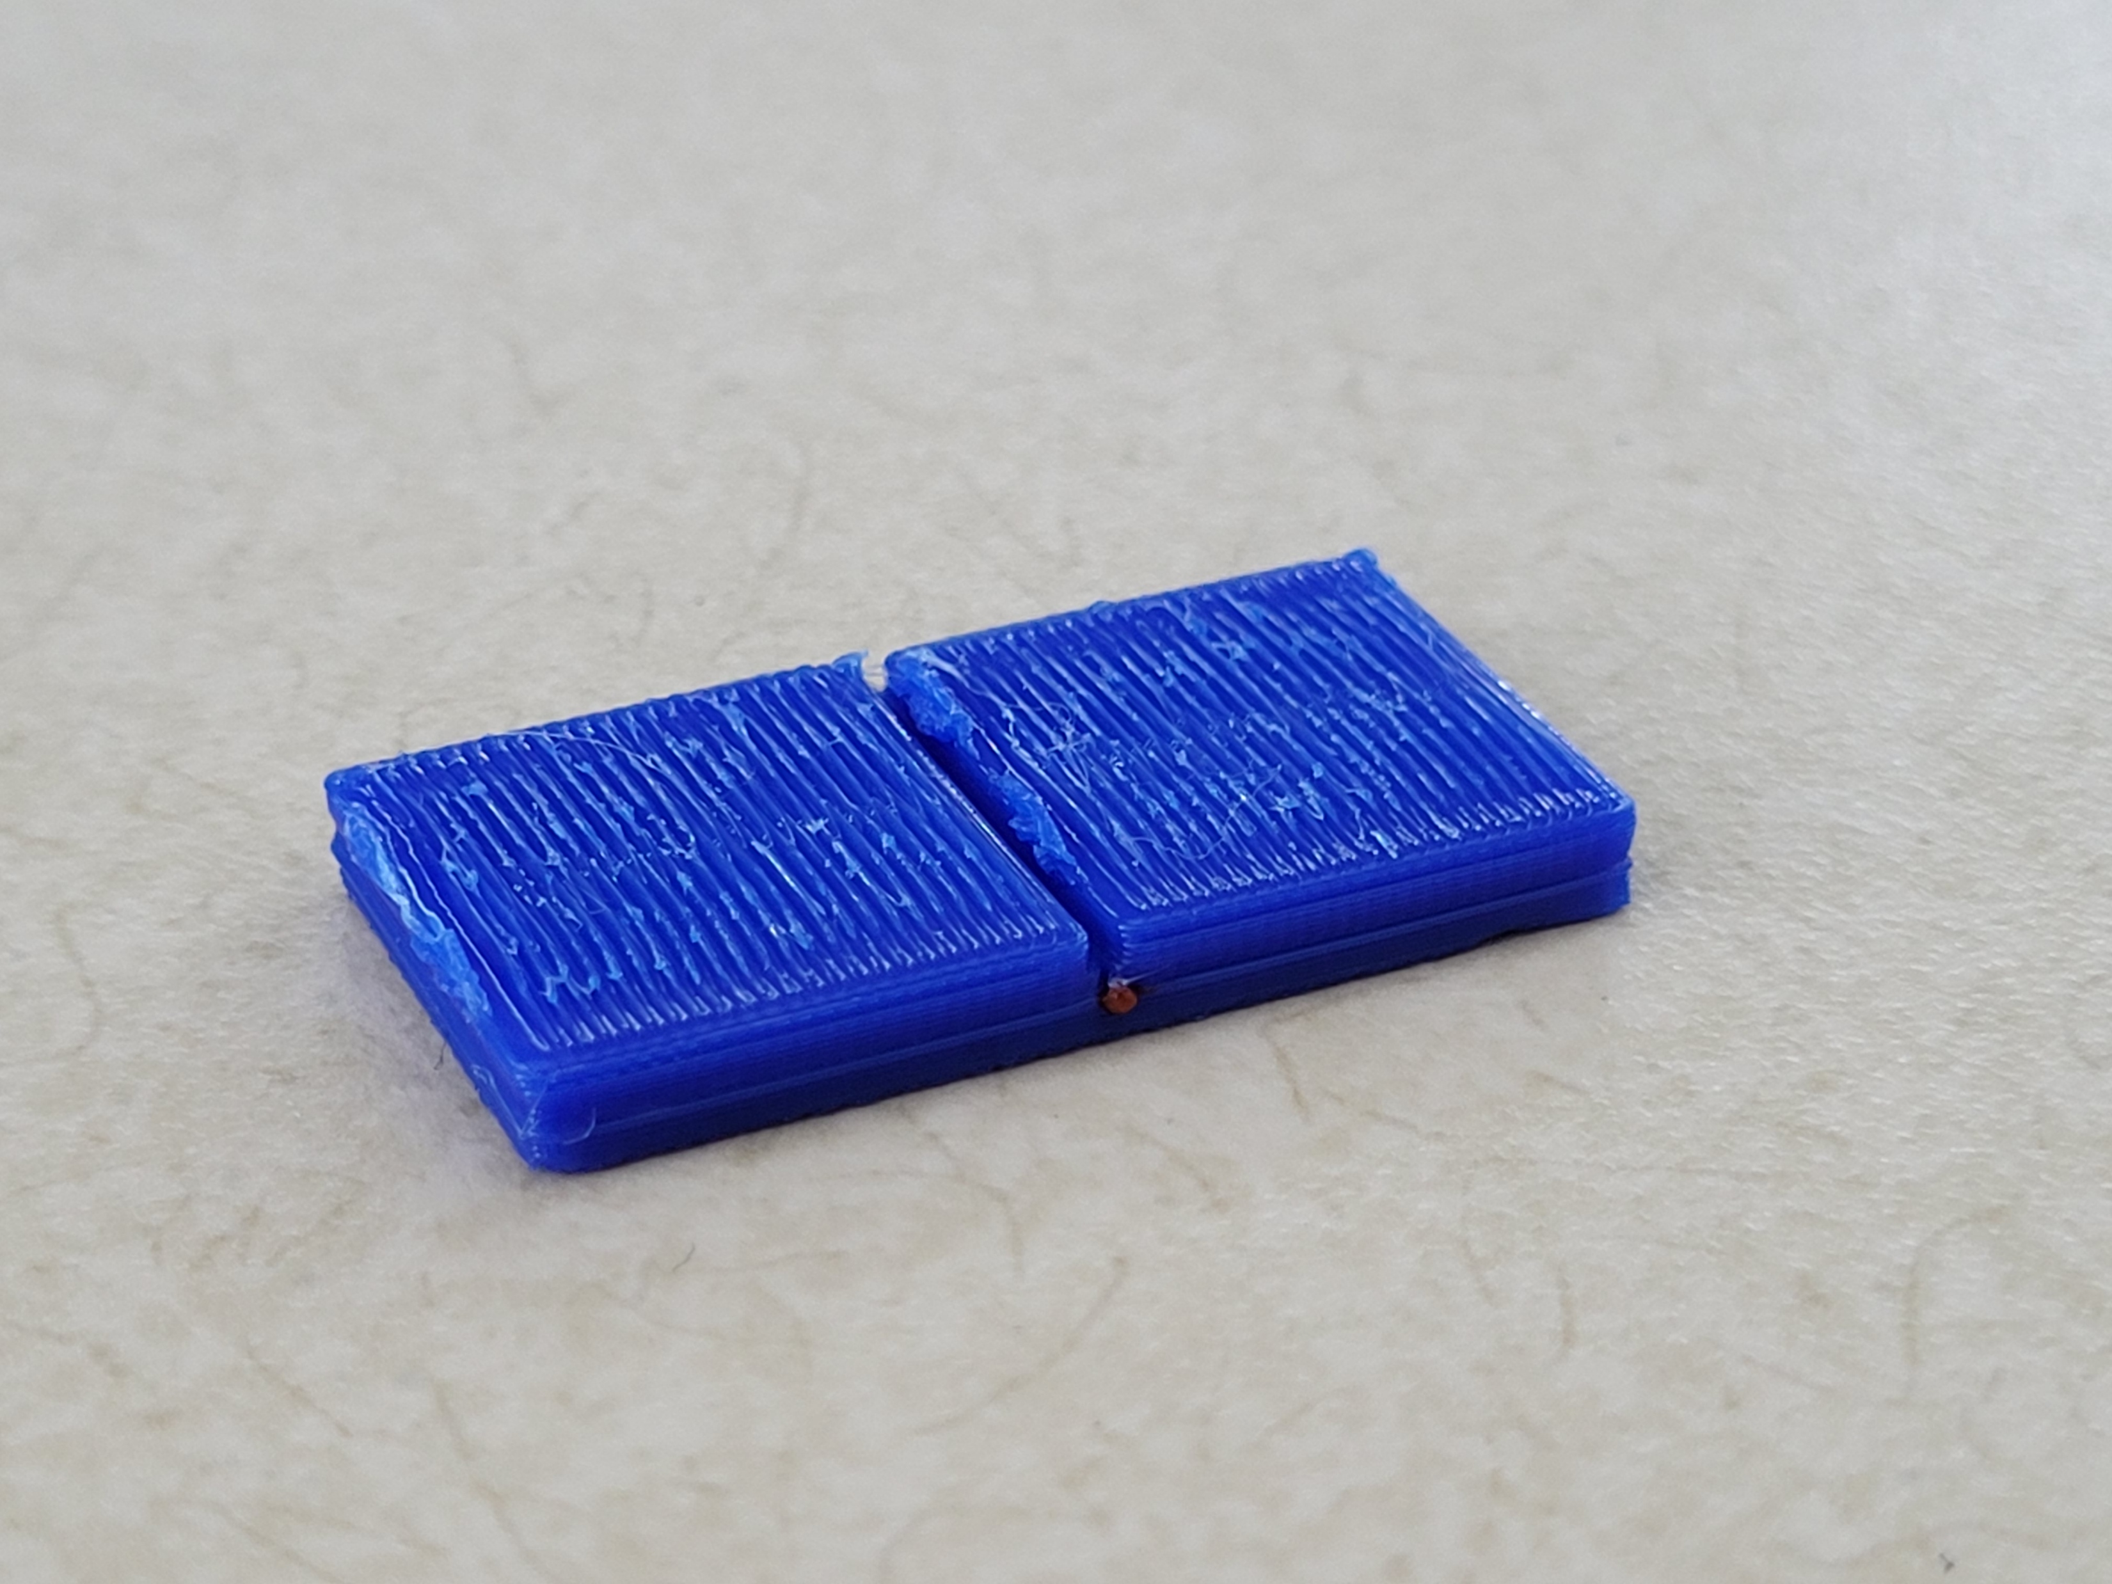
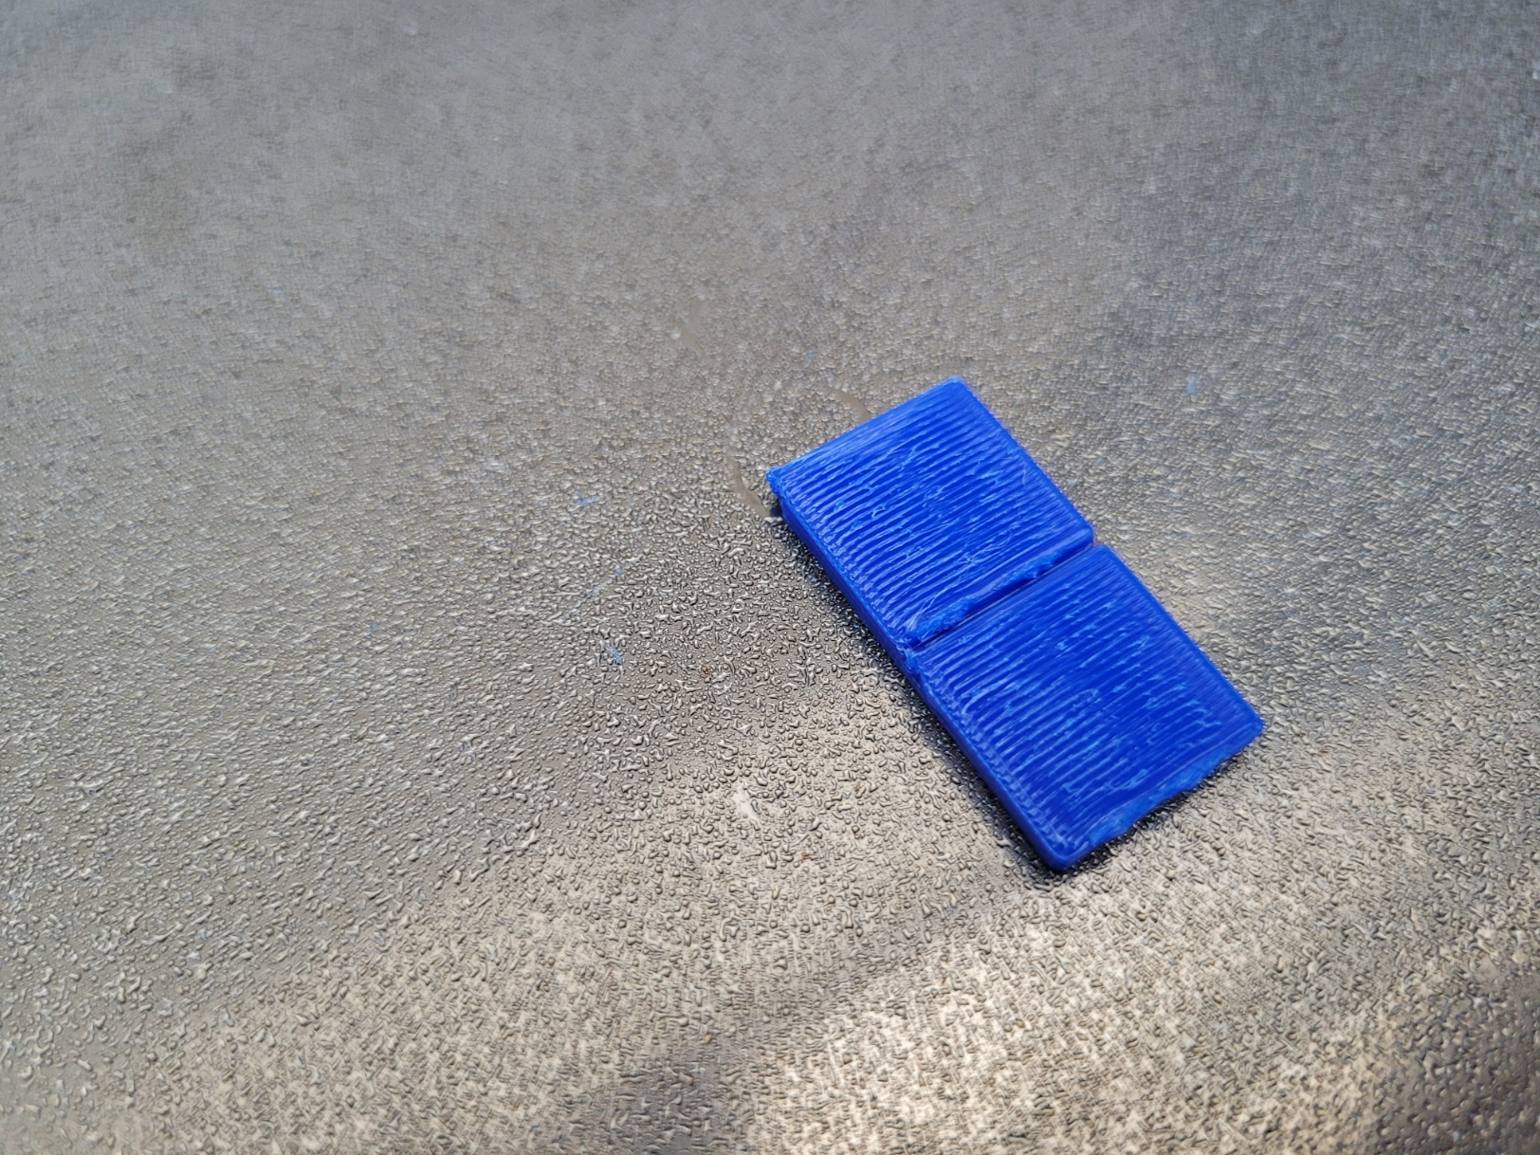
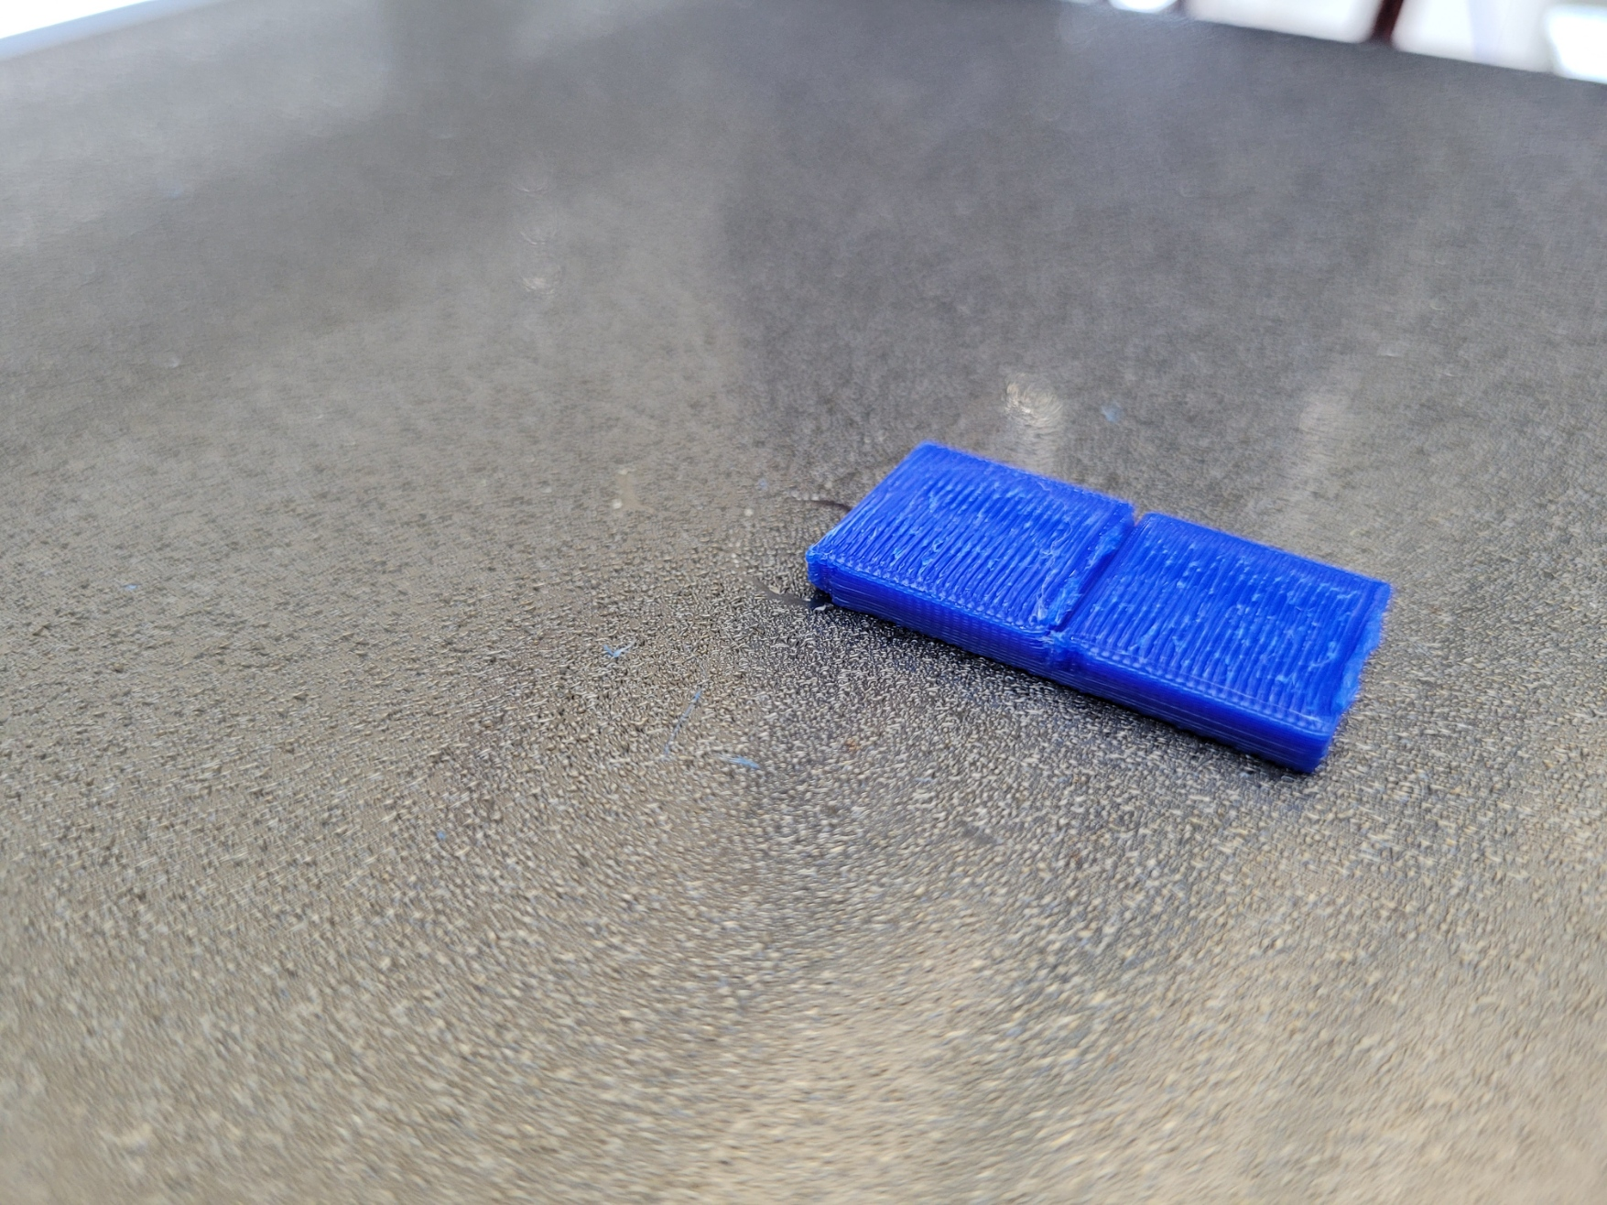
05/26/2022 – 3D Multitool
Overall, not bad! The red lines didn’t end up showing up because by the time it was at the nozzle, the line was already finished. Maybe will add a pre-extrude process when changing tools.

Slide 35
05/26/2022 – Some Questions
For the extrusion component, where does VespidaeTools.Operation.createExtrudeOps live? Was hoping to dig a little bit deeper into that.
Not a question, but will also poke around clipper to better understand the offset options

Slide 36
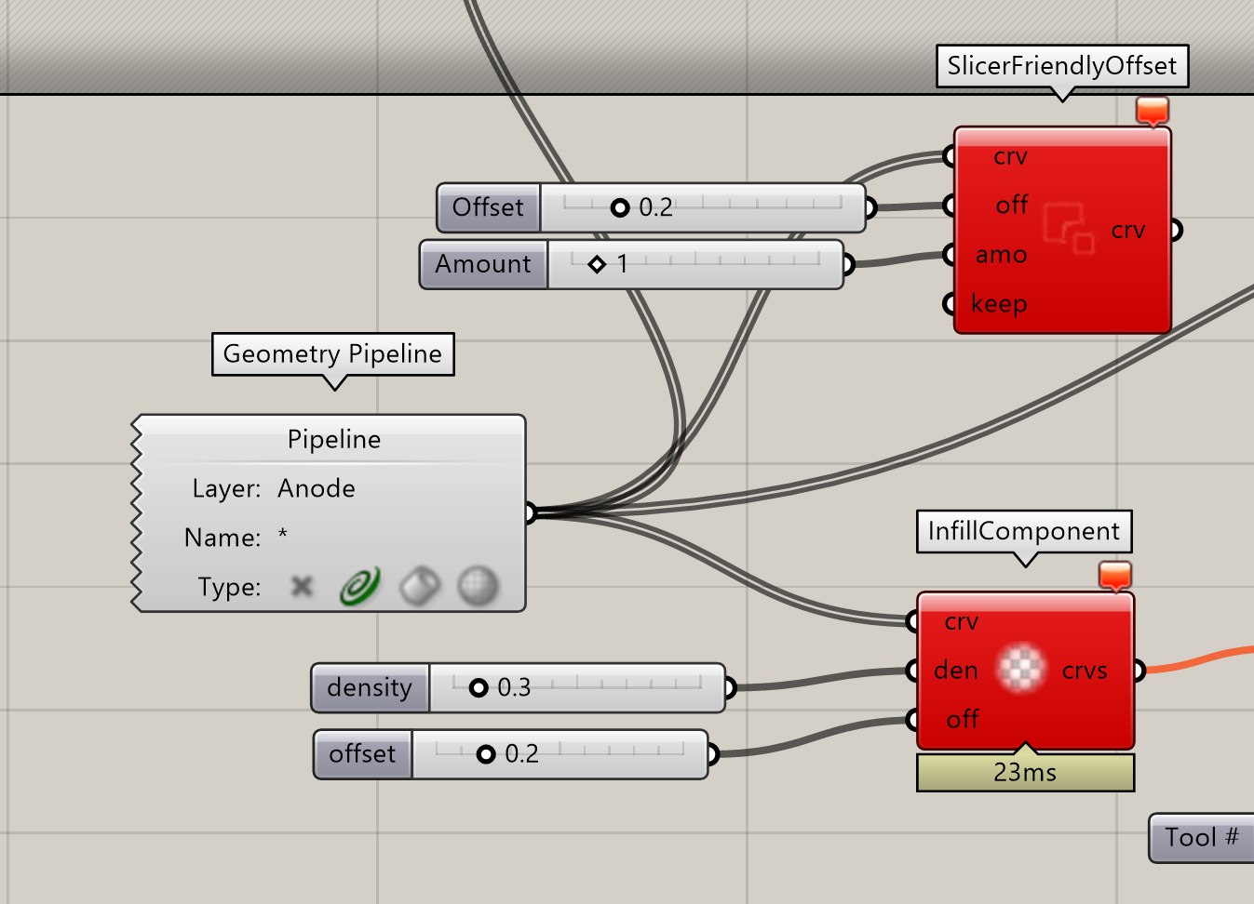
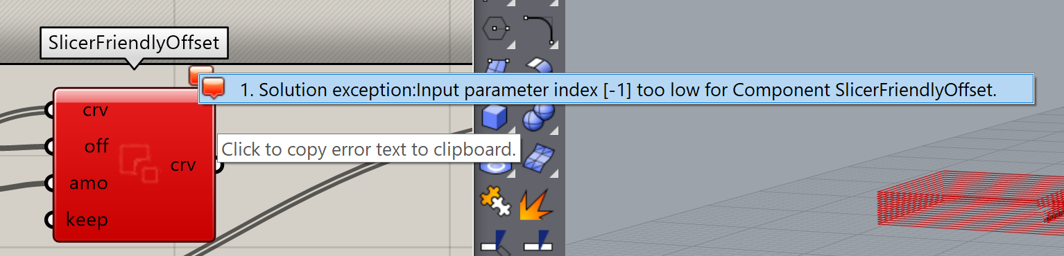
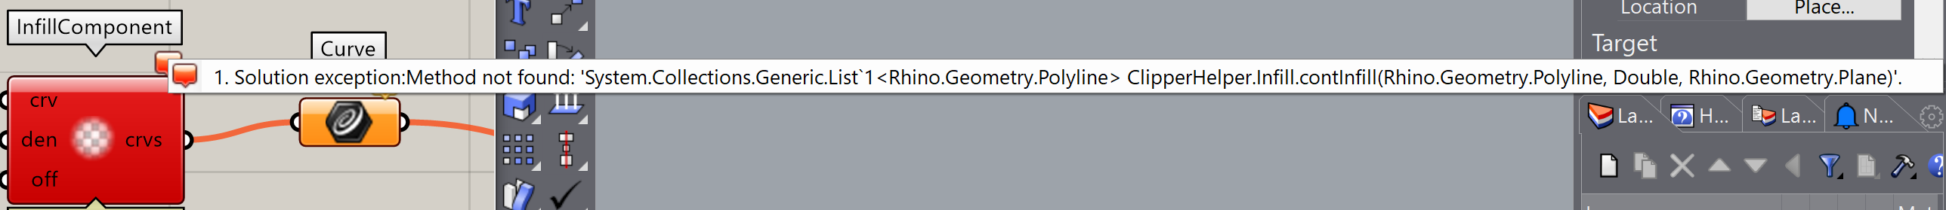
05/31/2022 – 3D Multitool Take 2
Downloaded the newest build and ran into some issues with how these run

Slide 37
05/31/2022 – 3D Multitool Take 2
I’m not sure why it doesn’t see this, though it looks like the method this one is looking for is asking for 3 inputs, but the contInfill method I’m looking at has 4 (curve, density, angle, plane)
Wait, maybe this didn’t update correctly. I’ll try this again.
Oh! I realized the actual Vespidae build hasn’t been updated since 5/5 even though all the other libraries have been updated. Probably will need a rebuild.
Realized the builds are currently being stored as Debug builds, but I’ve uploaded it to my Grasshopper, so I think we’re good to go now

Slide 38
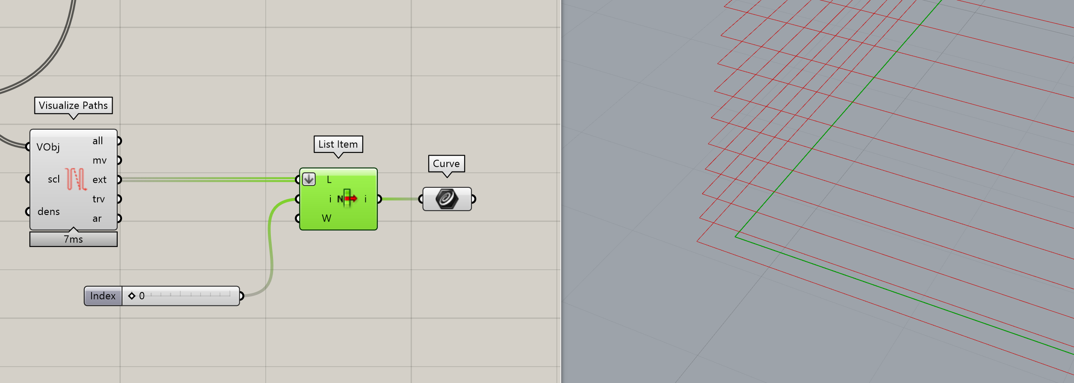
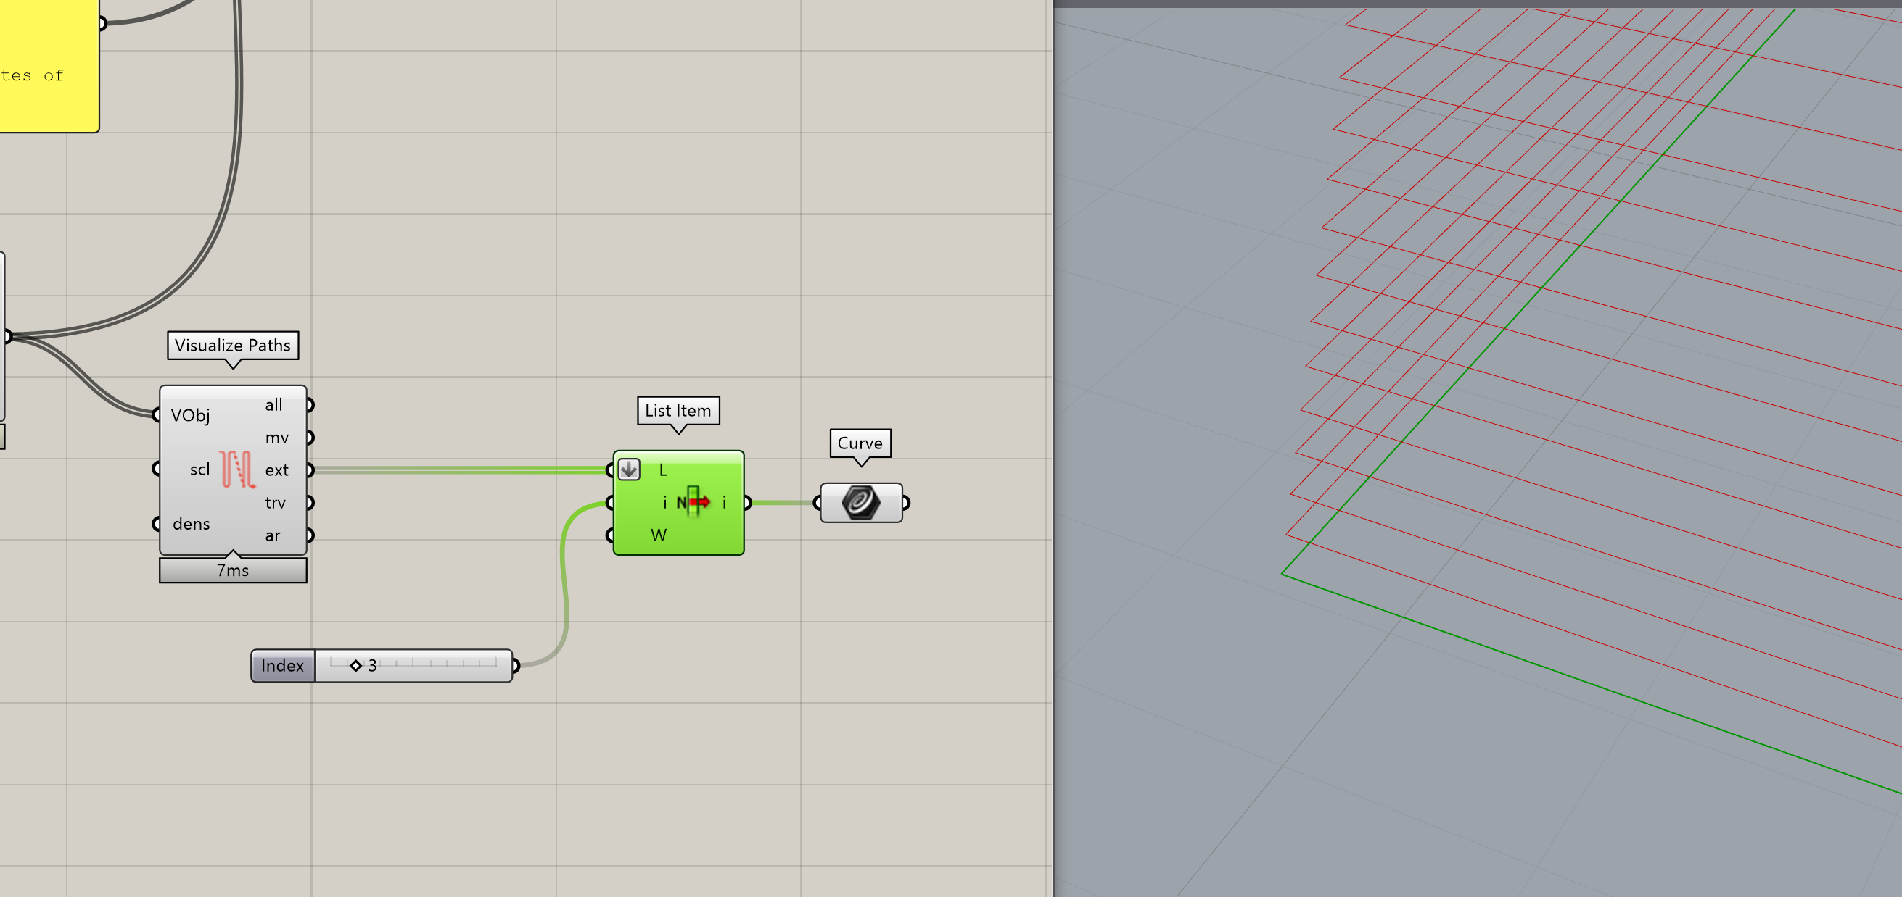
05/31/2022 – 3D Multitool Take 2
Wahoo! This works much better. Probably also explains why I didn’t have all the infills go into one layer last time.
Offsets and infill seem to work great, no more weird shapes in between anymore.
Observation: It looks like the solver will start printing the shell offsets before printing the original one. So it will go inwards, then end printing the shells with the outermost one, before going back in to the infill.

Slide 39



05/31/2022 – 3D Multitool Take 2
Overall pretty successful. I still need to improve the wiping and retraction workflow, but I think that’s more of a Vinh task
I’ll look at adding a more interesting example

Slide 40
06/01/2022 – Back to Batteries
Went back to printing battery toolpaths, just slightly enlarged to make it easier to evaluate toolpaths
Eventually will make these smaller to sizes I want, but that will require fine tuning extrusions/retractions/wiping to make sure I get just the right amount of material
3 tool print, multiple layers and toolchanges w/ Vespidae

Slide 41
06/01/2022 – Back to Batteries
Things to do on Vinh’s end
XY calibration of all the toolheads, looks slightly off
Better priming/wiping methods for the toolheads
Watching the tool switches, I think now I’m thinking more about how I organize the tools and thinking about the order I actually want to process things. E.g. I had my tools in a certain order, and now I think that I want to completely change the order my filaments are in to minimize tool changes and optimize my process a little bit better.

Slide 42
06/01/2022 – Battery Thoughts
Vespidae really helps with my process and gives me a lot more granular control of my designs, which wouldn’t be possible with standard slicers. I’m now able to iterate quickly and efficiently, without the need to juggle multiple programs just to try small tweaks. Having the ability to tune the finer details in my toolpath also make more closely consider my designs and examine how I can improve my devices through toolpath optimization.

Slide 43






06/01/2022 – Pictures
Sanded Cross Section. Not a great photo ☹

Slide 44
07/05/2022 – More Batteries
Sorry for the delay! Had 1 week of vacation and have been getting an intern up to speed on various projects around lab, including this one.
The intern has been calibrating all the tools on the Jubilee, so that we can get cross sections that actually look like the designed architecture.
It’s mostly a success, but there’s still work to be done to better tune extrusion parameters and improve adhesion. But comparitively is much improved

Slide 45



07/05/2022 – More Batteries
I ended up cutting the edges to take better cross section photos, but the top layer also looks a lot neater in general. Colors are more defined which suggests less bleeding between filaments
The actual cross section is way better because you can see all three colors (couldn’t see gray before), and if you squint you can see the pillar/interdigitated patterns.

Slide 46
07/05/2022 – Moving Forward
New things to try
Play around more with extrusion parameters to get better adhesion. That should help a lot with quality, especially on first layer
Syringe is up and running! Currently set up for only manual on/off but I’m hoping to get some images of printing gels in some PLA trenches
I’d like to try my hand at getting Vespidae to handle automatic on/off of the dispensers. It should be basically like a move command but with extra G-code at the beginning and end of each move. It’s already almost possible with the g-inject parameter, but I need something at the end as well to turn off the dispenser before travelling.

Slide 47

07/11/2022 – Dispenser On/Off Print
Made some updated to Vespidae, specifically the move component and the associated objects in Gmaker
Added a gPost to inject gcode at the end of the move as well, to enable on/off control of dispenser
Seems to work in new T08 test in Grasshopper, will test physically printing either today or tomorrow
Built geometry only in Grasshopper, so no
associated Rhino file

Slide 48

07/12/2022 – Dispenser Prints
Tested line prints and things are functioning as expected. So far only printing simple snake/line patterns but going to see if I can add that to the battery toolpath as well.
Ideally looking to see how well it can fill in multi-layer trenches, which would be ideal from a processing standpoint.

Slide 49






08/03/2022 – Battery Prints
Went on a tangent to get this up and running on the Aerotech (this is in a different branch, see details there)
Back to trying to print batteries and trying to get better media for it
Running a variation of the same toolpaths (T11), and taking a picture during toolchanges
These still don’t look amazing, especially since the edges seem to still have a little extra globbing of material

Slide 50




08/03/2022 – Battery Prints
Tried to take some microscope pictures as well. Definitely need a better setup for this, but I’m thinking these pictures can be useful for showing quick improvements through rapid iterations?
That also requires a geometry that’s actually good… So far these pictures are only vaguely reminiscent of the geometries (though that’s also part of how PLA looks?)

Slide 51
08/03/2022 – Battery Prints (Videos)
I took some videos of the prints! They’re in a folder in the test log so that this doesn’t become a ridiculously big powerpoint.
These prints also take a while right now, and I think it could probably be faster

Slide 52

08/03/2022 – Battery Toolpath Adjustment
Adjusting Battery toolpath so the separator (yellow) can be a bit more distinct (larger yellow areas)
Video of print is also in folder. Side views are not pretty. Will try to clean it up and take some microscope cross sections tomorrow

Slide 53
08/10/2022 – T12 Battery (Extrude + Syringe)
Updated battery toolpaths & grasshopper for a dual extrude and syringe option. This is probably the biggest case for why this particular design can’t be handled by commercial slicers, since we have digital on/off of syringes but also need extrusion
Other patterns could also help demonstrate why we need Vespidae (especially for some pillar designs
Video is uploaded and Vespidae now can handle generic solutions w/ extrusion & syringe, sorting by layer. Can’t handle sort by extrusion type in this case, but for now that’s okay.
The actual code works fine, but with the hairgel extrusion, I can’t actually extrude PLA onto it because it doesn’t adhere. Adhesion is potentially less of a concern later on because the separator ink can be cured to a solid, ceramic-like state but for now this doesn’t work
Video included

Slide 54
08/10/2022 – T12 Battery (Extrude & Syringe)
What I wrote on discord for tracking:
okay i finished editing the solver (generic) so that it can support extrusion & on/off syringe. This is probably the most compelling case for Vespidae with the current battery geometry besides trying to achieve the resolutions necessary because i don't think you can do this with regular slicers. Right now I was doing layer by layer, but if it works with the materials, I would actually like to skip a couple of syringe layers and then fill in the gaps at the very end
unfortunately with printing hairgel, the problem end up being the PLA won't adhere to it so I end up with a pretty bad print, so i pivoted back to printing with all extrusion. I got some better videos and the cross sections get closer to what i want battery wise. I haven't done any measurement, but this is 5 layers stuffed into approximately .5mm thickness?

Slide 55





08/10/2022 – T13 Battery Toolpaths (Extrude)
Updated toolpaths to better see cross section & improve quality of prints
Glass slides (top/bottom) each ~1mm thick
Achieving better resolution, closer to the
Interdigitated trench design from slide 18

Slide 56
08/10/2022 – T13 Battery Toolpaths (Extrude)
Videos are uploaded
The side view is really ugly, but also shows areas for improvement. Still need to take improve retract/dispense to get rid of the oozing at beginning & end. Not sure how to go about this
Also there’s a weird thing in the sort where it seems to not be sorting by tool, or sorts by extrusion type first. Will look into that.

